Slide 1

Primary care induction Programme
Understanding Our Population, Communities and Local Health System

Slide 2
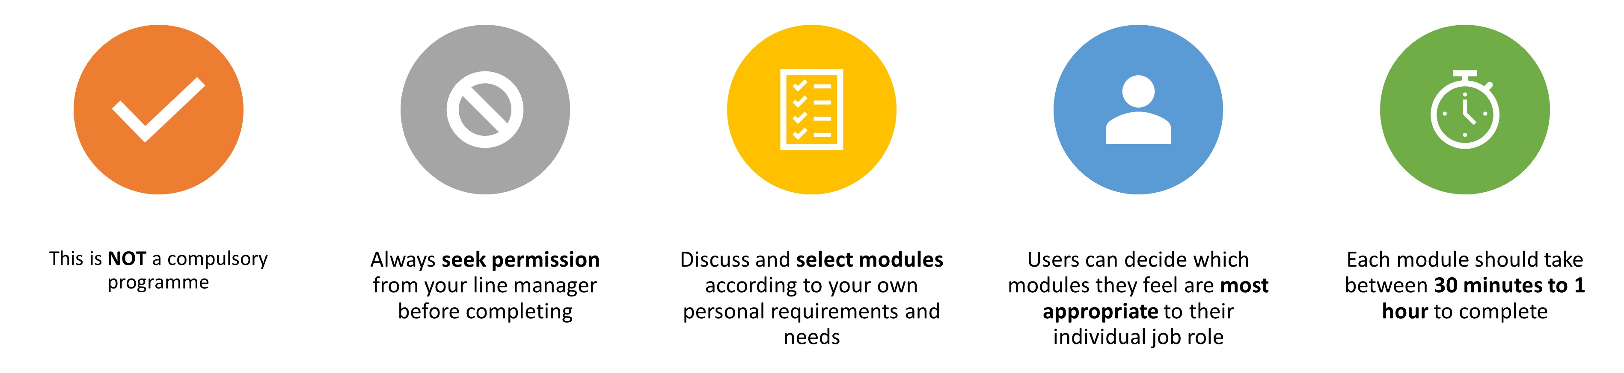
Important Information
Slides are interactive and require the user to click through information using a mouse or space bar.
To view videos in a larger format or full screen, they can be viewed externally at source. Please click the source title e.g. YouTube in bottom left-hand corner, and it will take you to a full screen to view.
For Subtitles and closed captions, please click the ‘CC’ logo at the bottom of the video on the left-hand side once launched.
Important Notice – Organisational Transition
Please note that NHS Integrated Care Boards (ICBs) are currently undergoing organisational restructuring. During this transition period, the Training Hub remains hosted by Norfolk and Suffolk ICB and continues to provide support across Norfolk, Suffolk and North East Essex, reflecting the previous organisational footprint.
As formal transition arrangements are implemented, some references within this induction programme, including organisational names, structures, contacts or branding, may not yet reflect the final arrangements. We appreciate your understanding and will update content as changes are confirmed
The Training Hub

Slide 3

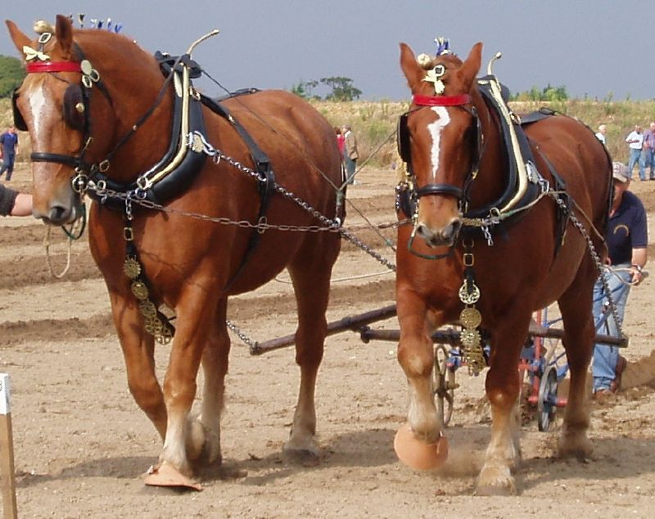
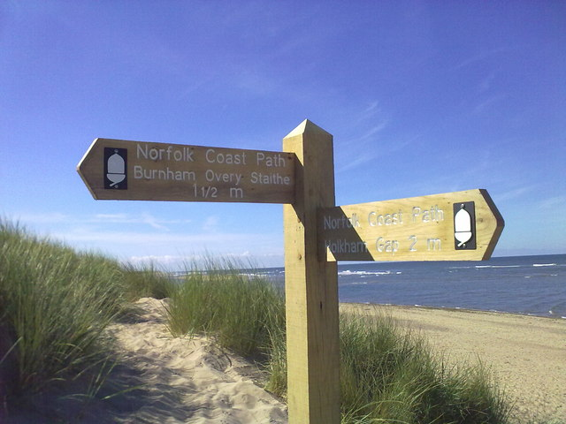
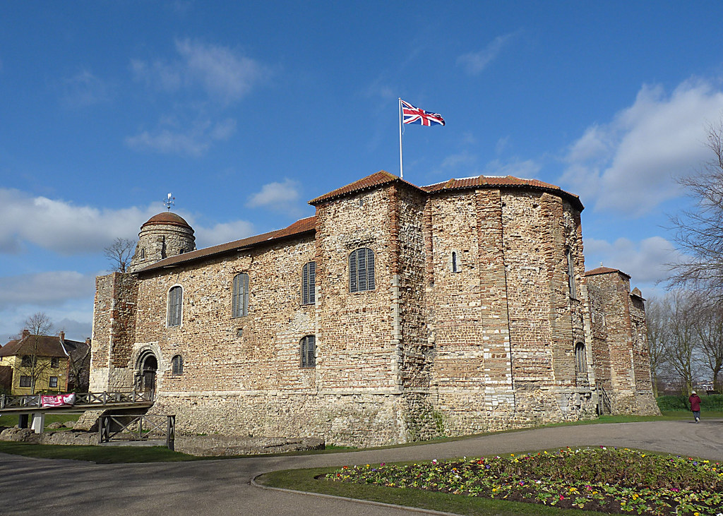
Introduction to Norfolk, Suffolk and North Essex
Understanding the communities we serve
Norfolk, Suffolk and North Essex are home to diverse communities, each with unique health needs and challenges.
Our population includes:
Large urban centres such as Colchester, Norwich, Ipswich, Lowestoft and Great Yarmouth
Market towns and rural villages
Coastal communities
Areas of significant deprivation alongside some of England's most affluent neighbourhoods
Growing numbers of older people living with long-term conditions
Understanding our local communities helps us provide safe, effective and person-centred care.
ONS Population Estimates, Norfolk Insights Suffolk Observatory (2026)
These photos by Unknown Author are licensed under CC BY-SA

Slide 4

Welcome to Norfolk, Suffolk and North Essex
Who Lives Here?
Norfolk, Suffolk and North Essex are home to approximately 2 million people.
Key characteristics include:
An ageing population
Increasing numbers of people living with multiple long-term conditions
Growing demand for health and care services
Significant variation in health outcomes between communities
Diverse cultural and socioeconomic backgrounds
Around half of residents live in rural or coastal areas, where access to services can be more challenging.
Approximately 219,000 people live in the 20% most deprived communities nationally. In these areas, early deaths are around 70% higher than in the least deprived areas.
These differences shape how we plan services and highlight why reducing inequality is central to our work.
(Norfolk and Suffolk ICS, 2026)
ONS Population Estimates, Norfolk Insights Suffolk Observatory (2026)

Slide 5
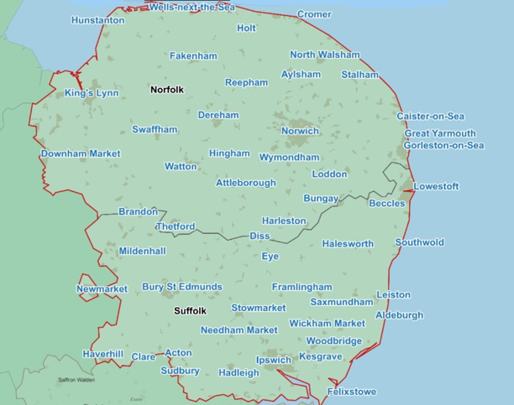
Norfolk and Suffolk ICB Footprint
Norfolk and Suffolk ICB is divided into geographical areas.
Originally based upon CCGs (Clinical Commission Groups), there are 3 sub-ICBs recognised by the Department of Health and Social Care and NHSE:
Ipswich & East Suffolk
West Suffolk
Norfolk & Waveney
Each of these sub-ICBs (referred to as Alliances) is then divided into PCNs and practices.
Additionally, Norfolk & Waveney is ‘unofficially’ subdivided into 5 additional localities, to facilitate administration of the entire Alliance.
Great Yarmouth & Waveney
Norwich
North Norfolk
South Norfolk
West Norfolk
For more information on the new Norfolk and Suffolk Alliances please visit: About us - Norfolk & Suffolk ICB

Slide 6
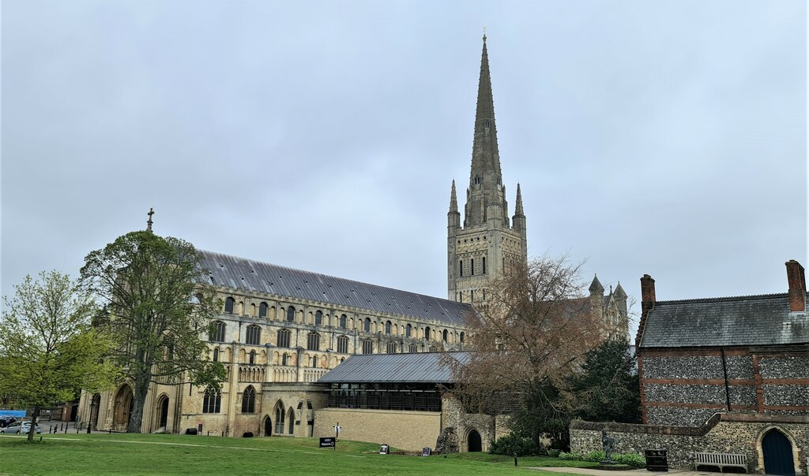
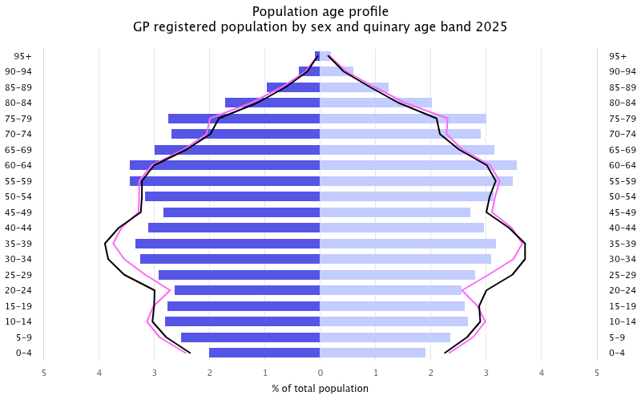
Norfolk and Waveney
Localities
Photo by Unknown Author, licensed under CC BY-SA
Norwich
East Norwich PCN
East Norwich Medical Partnership
Hellesdon Medical Practice
The Lionwood Medical Practice
Norwich Practices Health Centre
Old Catton Medical Practice
Prospect Medical Practice
Thorpewood Medical Practice
Woodcock Road Surgery
Norwich North PCN
Lawson Road Surgery
Magdalen Medical Practice
Oak Street Medical Practice
West Norwich PCN
Beechcroft & Old Palace Surgery
Marriots Medical Practice
Roundwell Medical Centre
Trinity & Bowthorpe Medical Practice
Wensum Valley Medical Practice
Central Norwich PCN
Castle Partnership
Lakenham Surgery
St Stephen’s Gate/Newmarket Road
West Pottergate Medical Practice
UEA Medical Centre
Norfolk and Waveney Alliance serves a population of approximately 1,097,427. There are 5 localities in the sub-ICB Norfolk & Waveney. In those localities are 18 PCNs comprised of 106 Practices.
Great Yarmouth and Waveney
Gorleston PCN
The Beaches Medical Practice
Millwood Partnership
Great Yarmouth and Northern Villages PCN
Coastal Villages
East Norfolk Medical Practice
Fleggburgh Surgery
Nelson Medical Centre
Park Surgery
Lowestoft PCN
Alexandra and Crestview Surgeries
Andaman Surgery
Bridge Road Surgery
High Street Surgery
Rosedale Surgery and Kirkley Mill Surgery
Victoria Road Surgery
Male | Female
For more information on the Norfolk and Waveney Alliance please visit: Norfolk & Suffolk ICB

Slide 7
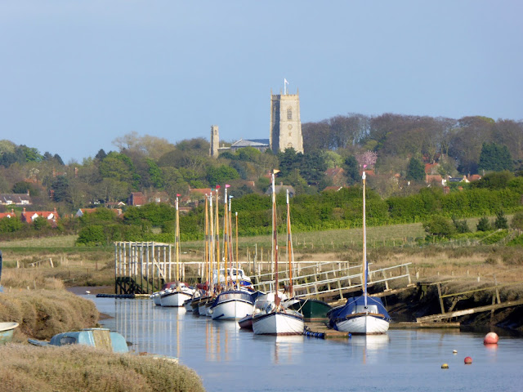

Norfolk and Waveney
Localities continued
North Norfolk
West Norfolk
NN1 PCN
Fakenham Medical Practice
Holt Medical Practice
Sheringham Medical Practice
NN2 PCN
Aldborough Surgery
Birchwood Medical Practice
Cromer Group Practice
Mundesley Medical Centre
Paston Surgery
NN3 PCN
Coltishall Medical Practice
Drayton Medical Practice
The Market Surgery
Reepham & Aylsham Medical Practice
NN4 PCN
Acle Medical Partnership
Blofield Surgery
Brundall Medical Partnership
Hoveton & Wroxham Medical Centre
Ludham & Stalham Green Surgeries
Staithe Surgery
Coastal PCN
The Burnham Surgery
Great Massingham & Docking Surgeries
Grimston Medical Centre
Heacham Group Practice
Wells Health Centre
Fens & Brecks PCN
Boughton Surgery
Feltwell Surgery
St Clements Surgery
St Johns Surgery
Upwell Medical Centre
Watlington Medical Centre
King’s Lynn PCN
Southgates Medical Centre
St James Medical Practice
The Woottons Surgery
Vida Healthcare
Swaffham & Downham PCN
Bridge Street Surgery
Campingland Surgery
The Hollies Surgery
Howdale Medical Centre
Litcham Health Centre
Manor Farm Medical Centre
The Plowright Medical Centre
SNhIP PCN
Attleborough Surgeries
Chet Valley Medical Practice
Church Hill, Pulham Market
Harleston Medical Practice
Heathgate Medical Practice
Lawns Medical Practices
Long Stratton Medical Practice (& Newton Flotman)
Old Mill & Millgates Medical Practice
Parish Fields Practice
South Norfolk
Ketts Oak PCN
East Harling & Kenninghall Medical Practice
Humbleyard Practice
Hingham Surgery
Windmill Surgery
Wymondham Medical Centre
Mid-Norfolk PCN
Elmham Surgery & Swanton Morley
Orchard Surgery
Mattishall & Lenwade Surgeries
Shipdham Surgery
Theatre Royal Surgery
Breckland Alliance PCN
Grove Surgery
School Lane Surgery
Watton Medical Practice

Slide 8

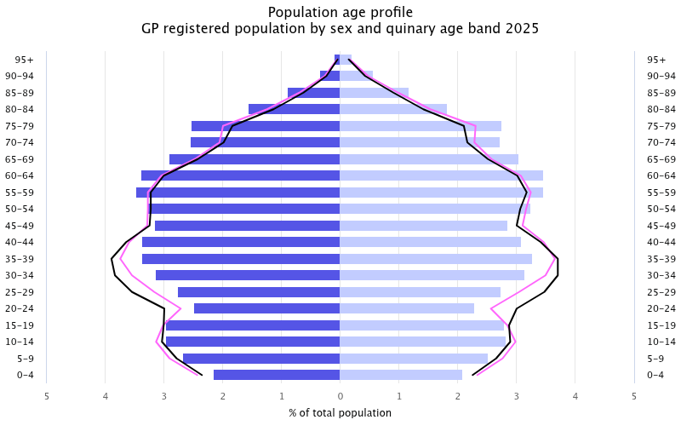
Ipswich and East Suffolk Alliance
Suffolk
Photo by Unknown Author, licensed under CC BY-SA
Ipswich & East Suffolk Alliance serves a population of approximately 417,361
.
Barrack Lane and Ivry Street Primary Care Network
Barrack Lane Medical Centre
Ivry Street Medical Practice
Deben Health Group South Primary Care Network
Framfield House Surgery
Little St John’s Street Surgery
The Peninsula Practice
Wickham Market Medical Centre
East Ipswich Primary Care Network
Drs Solway & Mallick
Orchard Medical Practice
Ravenswood Medical Practice
North East Coastal Primary Care Network
Framlingham Medical Practice
Leiston Surgery
Saxmundham Health
North East Ipswich Primary Care Network
Felixstowe Road Medical Practice
Two Rivers Medical Centre
Orwell Primary Care Network
Burlington Primary Care
Grove Medical Centre
Hawthorn Drive Surgery
There are 9 Primary Care Networks (PCNs) comprised of 34 practices
South Rural Primary Care Network
Bildeston Health Centre
Constable Country Medical Practice
Hadleigh & Boxford Group
Needham Market Country Practice
The Holbrook and Shotley Practice
Wolsey Primary Care Network
Cardinal Medical Practice
Martlesham Heath Surgery
Embrace Medical Centre
East Suffolk Primary Care Network
Combs Ford Surgery
Debenham Group Practice
Derby Road Practice
Eye Health Centre
Fressingfield Medical Centre
Haven Health
Howard House Surgery
Mendlesham Health Centre
Stow Health
Male | Female
For more information on Ipswich and east Alliance please visit: Norfolk & Suffolk ICB

Slide 9
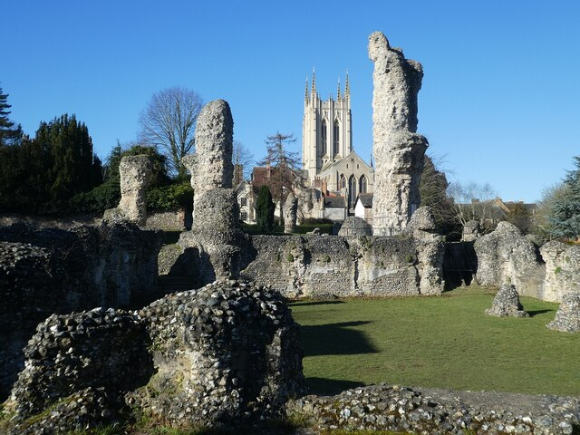
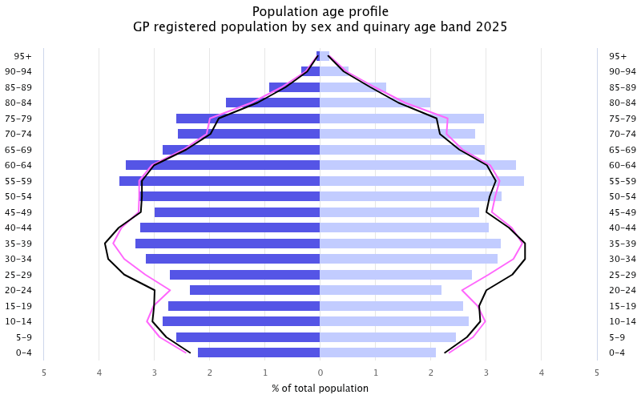
West Suffolk Alliance
Suffolk
Blackbourne Primary Care Network
Botesdale Health Centre
Ixworth Surgery
Stanton Surgery
Woolpit Health Centre
Bury St Edmunds Primary Care Network
Angel Hill General Practice
Guildhall and Barrow Surgery
Mount Farm Surgery
Swan Surgery
Victoria Surgery
West Suffolk serves a population of approximately 280,454.
There are 6 PCNs comprised of 23 practices
Haverhill Primary Care Network
Haverhill Family Practice
Unity Healthcare
Sudbury Primary Care Network
Hardwicke House Group Practice
Siam Surgery
West Suffolk Rural Primary Care Network
Clare Guildhall Surgery
Wickhambrook Surgery
Forest Heath Primary Care Network
Brandon Medical Practice
Forest Surgery
Lakenheath Surgery
Market Cross Surgery
Oakfield Surgery
Orchard House Surgery
The Reynard Surgery
The Rookery Medical Centre
Male | Female
For more information on West Suffolk please visit: Norfolk & Suffolk ICB

Slide 10
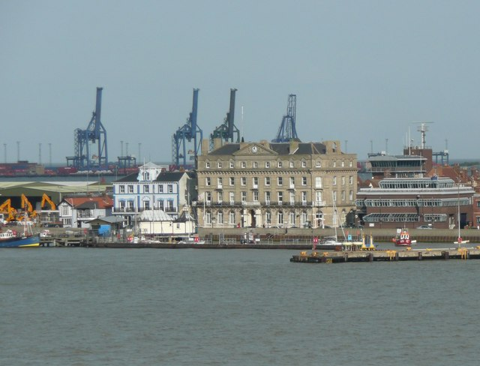
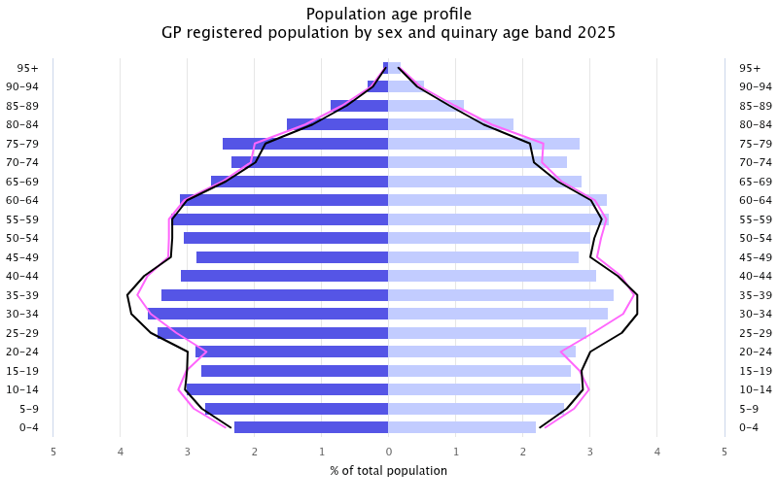
North Essex Alliance
Essex
Clacton Primary Care Network
East Lynne Medical Centre
North Clacton Medical Group
Old Road Surgery
Thorpe Surgery
Abbey Field Primary Care Network
Abbey Field Medical Centre
Ambrose Avenue Group Practice
East Hill Surgery
Rowhedge & University of Essex Medical Practice
Tollgate Health Centre
Wivenhoe Surgery
North Essex serves a population of approximately 380,796
There are 7 PCNs comprised of 33 practices
Colchester Medical Practice Primary Care Network
Castle Gardens Medical Centre
Parsons Health Medical Practice
Shrub End Surgery
Wimpole Road
North Colchester Primary Care Network
Highwoods Surgery
Lawford Surgery
Mersea Island Medical Centre
Mill Road Surgery
Tiptree Medical Centre
Winstree Medical Practice
Creffield Medical Group Primary Care Network
Creffield Medical Group
Turner Road Surgery
Tendring Primary Care Network
Caradoc Surgery
Clacton Community Practices
Colne Medical Centre
Great Bentley Surgery
Ranworth Surgery
St James Surgery
Walton Medical Centre
Stour Estuary Primary Care Network
Fronks Road Family Surgery
Harewood Surgery
Mayflower Medical Centre
The Ardleigh Surgery
The Riverside Health Centre
Male | Female
For more information on the North Essex Alliance please visit: Primary care North Essex | GP, pharmacy and dental services

Slide 11
What Influences Health?
Wider determinants of health include:
Why this matters
Housing
Employment
Education
Income
Transport
Environment
Social connections
Access to services
Patients may face challenges that affect their ability to:
Attend appointments
Manage medications
Maintain healthy lifestyles
Access support services
For Further Information on determinants of health please visit:
The King's Fund – What are the wider determinants of health?
Office for Health Improvement and Disparities (OHID)
NHS England – Core20PLUS5

Slide 12

Health Inequalities
Health inequalities are avoidable differences in health between groups of people.
Not everyone has the same opportunity to live a healthy life
Rural isolation
Poor transport links
Coastal deprivation
Social isolation
Lower healthy life expectancy in some communities
Reduced access to services for vulnerable groups
What can primary care do?
Primary care plays a vital role in:
Early intervention
Prevention
Signposting
Improving access
Reducing health inequalities
Further Information:
NHS England – What are Health Inequalities
The King's Fund – Health Inequalities Explained
Health Foundation – Health Inequalities Programme

Slide 13

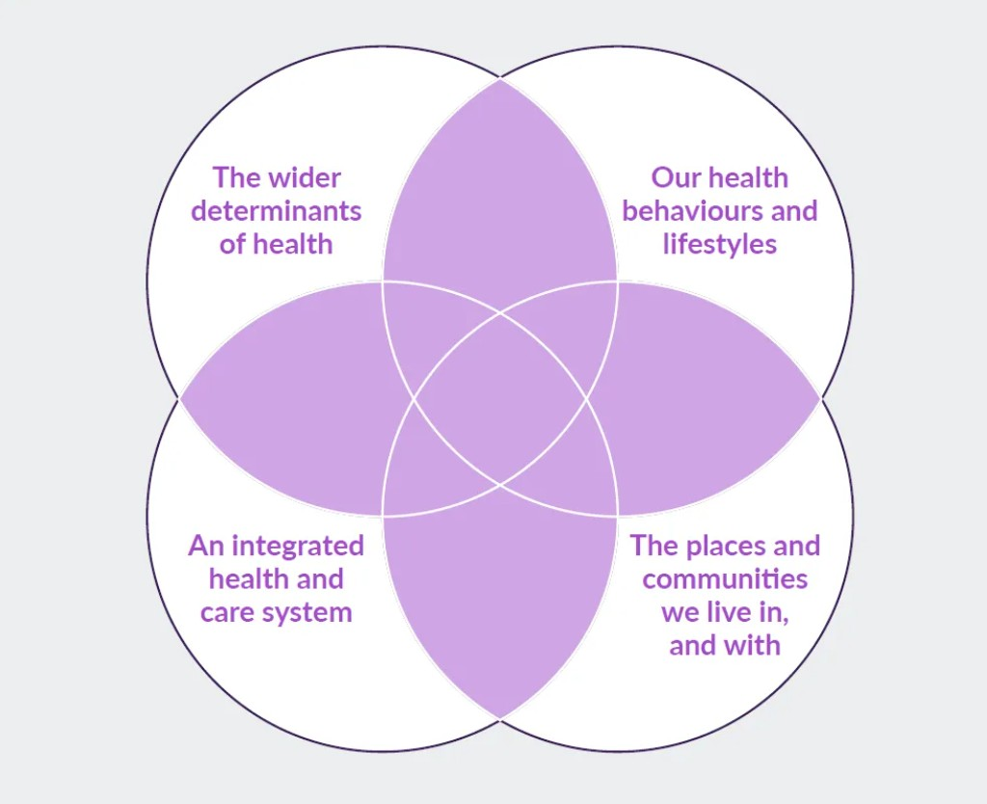
Population Health
What is Population health and why do we need it?
Population health focuses on improving health outcomes for entire groups of people whilst reducing inequalities.
A population health approach looks at:
Physical health
Mental health
Wellbeing
Prevention
Social factors affecting health
Source: Dahlgren G, Whitehead M 1993
In practice this means:
Using information about local communities to identify needs and deliver support where it will have the greatest impact.
For more information on Population Health please visit: A Vision For Population Health | The King's Fund

Slide 14
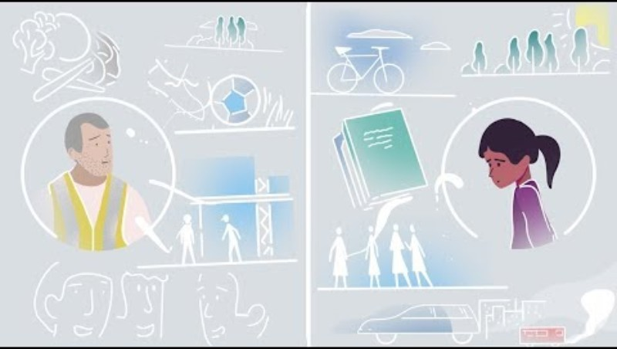
VIDEO: What is population health?
VIDEO: The King’s Fund: What is population Health? (The King’s Fund, 2021) Click image to access

Slide 15


Population Health Management
What is Population Health Management (PHM) and why do we need it?
Population Health Management (PHM) improves population health through data-driven planning and the delivery of proactive care to optimise health outcomes. It is essentially about moving from a largely reactive system (that is responding when someone becomes unwell) moving to a much more proactive system.
PHM is a partnership approach across the NHS and other public services including local authorities, emergency services, schools, the voluntary sector, housing associations, social services, patient groups, communities, and the public. All have a role to play in addressing the interdependent issues that affect people’s health and wellbeing.
PHM uses data, both healthcare data from clinical systems and non-healthcare data from sources including local authority and social services
Population Health Management (PHM) will be a core enabler and function of integrated care systems in helping drive a data led focus on person-centred care.
For further information on population health management please visit:
NHS England – Population Health Management
Faculty of Public Health
Please also access ‘Introduction to population health management’ e-lfh module for further learning.
NHS England, 2025

Slide 16
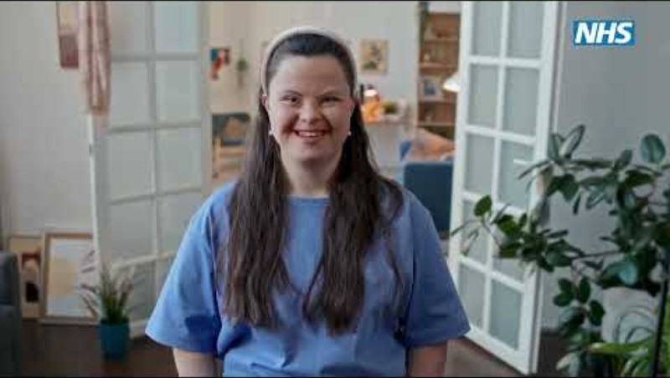
VIDEO: Population health management
VIDEO: Population health management: proactive, targeted healthcare for your community? (NHSE, 2024) Click image to access

Slide 17
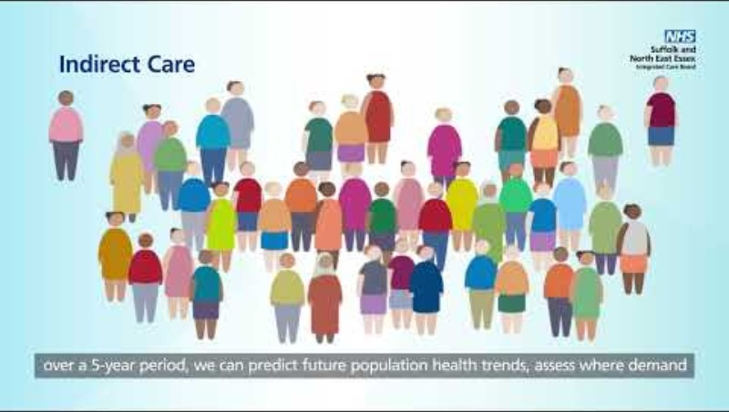
VIDEO: Population Health Management: what does it mean for me?
VIDEO: Population Health Management: what does it mean for me? (NHS Norfolk and Suffolk ICB, 2025) Click image to access

Slide 18
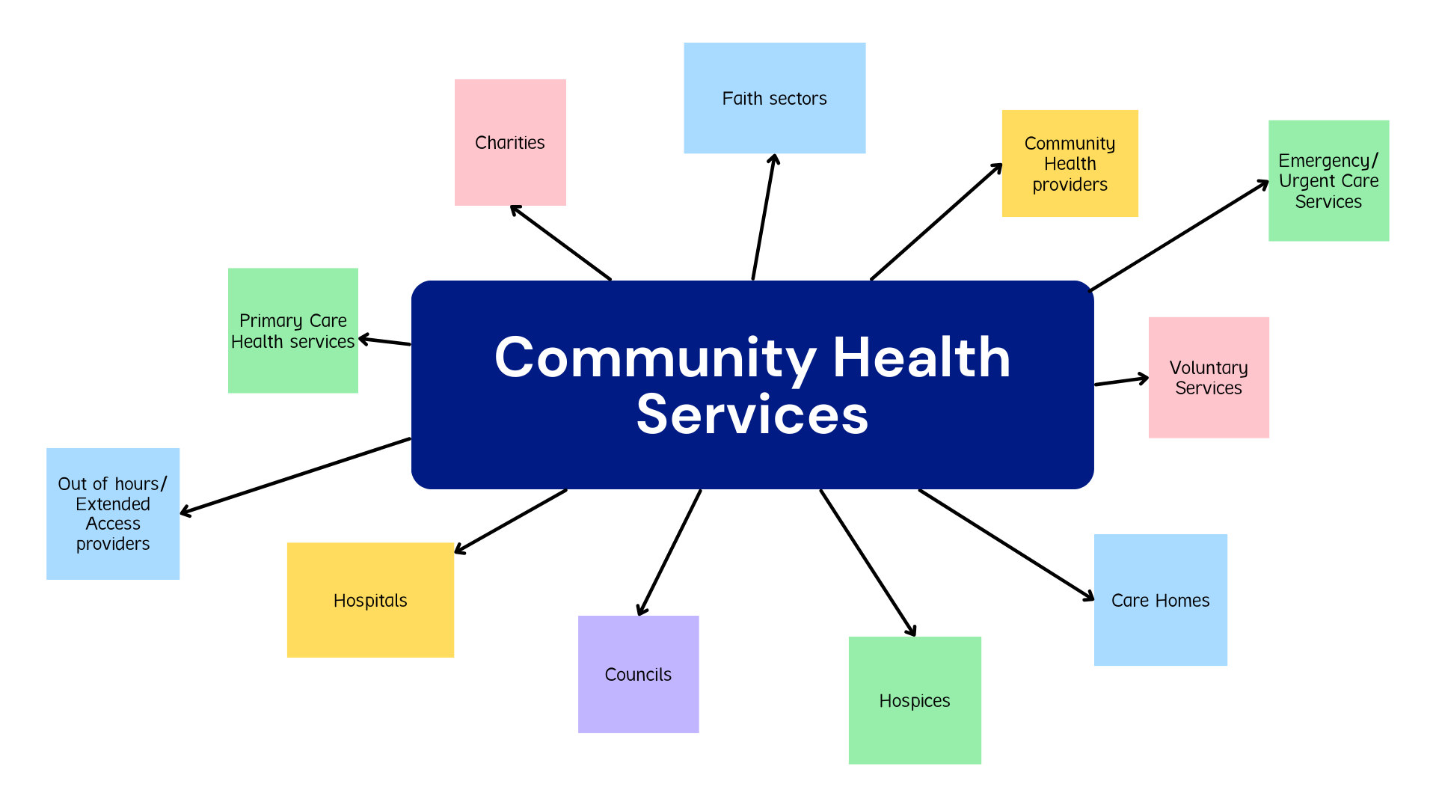
Community Health services
Norfolk, Suffolk, and North Essex Community Health Services
The community health services sector covers a wide range of services, from those targeted at people living with complex health and care needs - such as district nursing and palliative care - to health promotion services - such as school nursing and health visiting.
Community services play a key role in keeping people well, treating and managing acute illness and long-term conditions, and supporting people to live independently in their own homes (Kingsfund 2023).
For a comprehensive list of Norfolk, Suffolk, and North Essex community health providers please contact your local ICB
Norfolk & Suffolk ICB
NHS Essex ICB | Supporting healthier lives across Essex
Further information on community services here

Slide 19

Working Together Around the Patient
General Practice
Community Pharmacy
Community Services
Social Care
Mental Health Services
Voluntary and Community Organisations
Modern healthcare depends on teamwork.
A patient may receive support from a variety of individuals and services across the health and social care system
For further Information on Integrated Care please visit:
The King's Fund – Integrated Care Explained
NHS England – Integrated Care Systems Resources

Slide 20
The Voluntary, Community and Social Enterprise Sector
Age UK
Citizens Advice
Suffolk Family Carers
Carers organisations
Community transport schemes
Bereavement support
Local wellbeing groups
The voluntary sector plays an important role in supporting health and wellbeing.
Many issues affecting health cannot be solved by healthcare services alone.

Slide 21
Supporting People Beyond Healthcare
Social Prescribing
Exercise groups
Debt advice
Housing support
Bereavement services
Volunteering opportunities
Community activities
Social prescribing connects people with community support that can improve their health and wellbeing. Social prescribing can help people manage wider issues affecting their health and quality of life.
For further information on social prescribing and personalised care, please visit:
National Academy for Social Prescribing
NHS England Social Prescribing
Personalised Care Institute

Slide 22
The Future: Neighbourhood Health
The NHS is increasingly focused on delivering care closer to home. Staff working across organisations and professional boundaries will become increasingly important moving forwards.
Greater collaboration between services
Increased focus on prevention
Stronger community partnerships
More integrated neighbourhood working
Improved patient experience
For further information on neighbourhood health and integrated neighbourhood working, please visit the resources below:
Neighbourhood Health Framework (DHSC and NHS England)
NHS England – Integrated Neighbourhood Working
The King's Fund – What is Neighbourhood Health?

Slide 23
Key Support Services Available to Primary Care
Primary care teams are supported by many specialist services. These may include the following:
Medicine Optimisation Teams: Supporting safe, effective and evidence-based prescribing.
Continuing Healthcare Teams: Supporting individuals with complex healthcare needs.
Infection Control Teams: Promoting safe practice and reducing infection risks.
Workforce and Education Teams: Supporting training, development and professional growth.
Safeguarding: Supporting the protection of adults and children at risk.
Further information about local support teams and services may be available through your local Integrated Care Board (ICB). As structures and teams can vary across regions, please contact your local ICB for the most up-to-date information relevant to your area. ADD LINKS TO BOTH ICB

Slide 24
Prevention and Early Intervention
Prevention is a core part of primary care
Immunisations
NHS Health Checks
Cancer screening programmes
Smoking cessation support
Weight management services
Cardiovascular disease prevention

Slide 25
Useful Resources
National Organisations | Local Resources
NHS England | NHS Norfolk and Suffolk ICB
The King's Fund | NHS Essex ICB
Health Foundation | Suffolk Observatory
NHS Employers | Norfolk Insight
e-Learning for Healthcare (e-LfH) | Community Action Suffolk
National Academy for Social Prescribing | Voluntary Norfolk
NICE | Training Hub Website
Care Quality Commission (CQC)

Slide 26
Module 2 completed
Understanding Our Population, Communities and Local Health System

