Slide 1


Primary care Induction Programme
Education and Training in
Primary Care

Slide 2
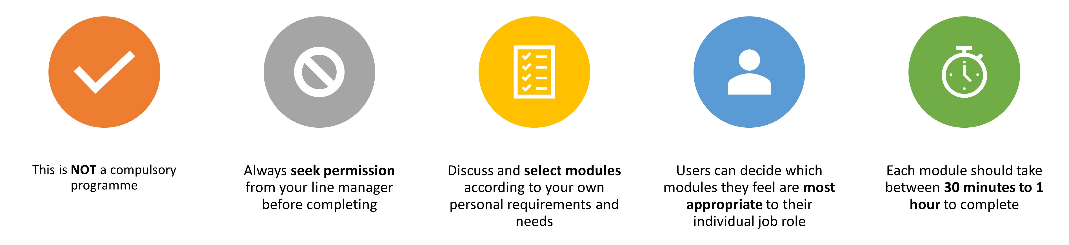
Important Information
Slides are interactive and require the user to click through information using a mouse or space bar.
To view videos in a larger format or full screen, they can be viewed externally at source. Please click the source title e.g. YouTube in bottom left hand corner, and it will take you to a full screen to view.
For Subtitles and closed captions, please click the ‘CC’ logo at the bottom of the video on the left-hand side once launched.
Please note:
The information included in this programme is correct at time of creation. Whilst we have made our best endeavours to make sure the information and materials included in this programme are from reputable sources, if you feel something has been missed or find any errors, please contact us as soon as possible. Thank you.
Norfolk and Suffolk Training Hub
training.hub@snee.nhs.uk

Slide 3
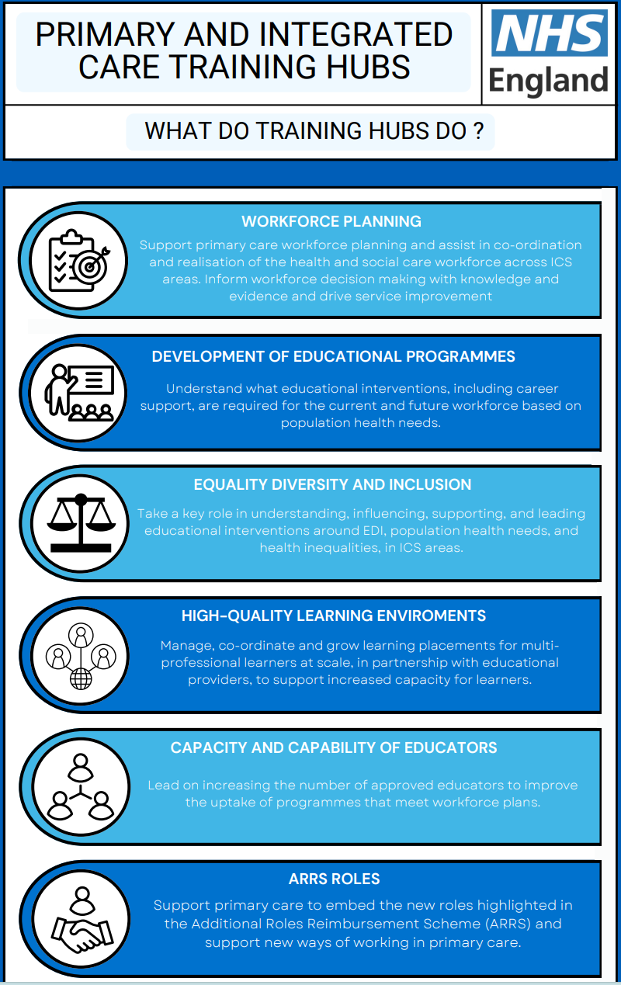
Introduction to Primary Care Training Hubs
What are Primary care Training Hubs?
Think of Training Hubs as your ‘go to’ place for any information about primary care workforce, education and development
Training Hubs bring together education and training resources from NHS organisations, community providers as well as local authorities.
They have access to a range of information, resources, apps and contacts within national and local networks who can offer practical guidance, support and advice
(NHSE, 2024)
Further details on Primary care Training Hubs can be found here

Slide 4

VIDEO: What are Training Hubs and how do you access them?
VIDEO: What are Training Hubs and how do you access them? (NHSE, 2022) Click image to access

Slide 5
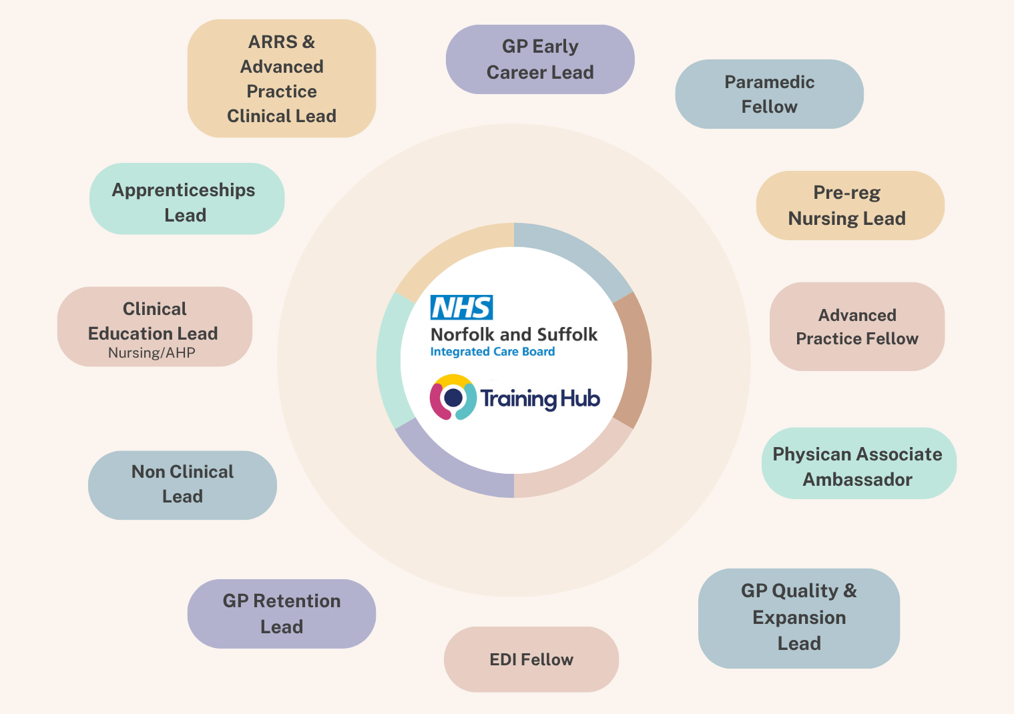
Introduction to The Training Hub
Training Hub Team
About us
The Training Hub’s key aim is to establish a local education and training infrastructure to help support the primary care workforce of today and tomorrow to ensure they have the necessary skills, values and behaviours to deliver high quality care.
At present we support those staff working within general practice in Norfolk, Suffolk and North Essex.
Further full details on The Training Hub please see our website
⚠️ Please note:
The Training Hub is currently hosted by NHS Norfolk and Suffolk ICB following the dissolution of NHS Suffolk and North East Essex (SNEE) ICB. As part of ongoing system alignment, arrangements for the North East Essex locality will transition to NHS Essex ICB. Please ensure you receive and follow updates from your local organisation regarding this position.
Further details on The Training Hub Team please see our ‘Meet the Team’ page

Slide 6

VIDEO: Training hubs and quality management
VIDEO: Training hubs and quality management (NHSE, 2021) Click image to access

Slide 7
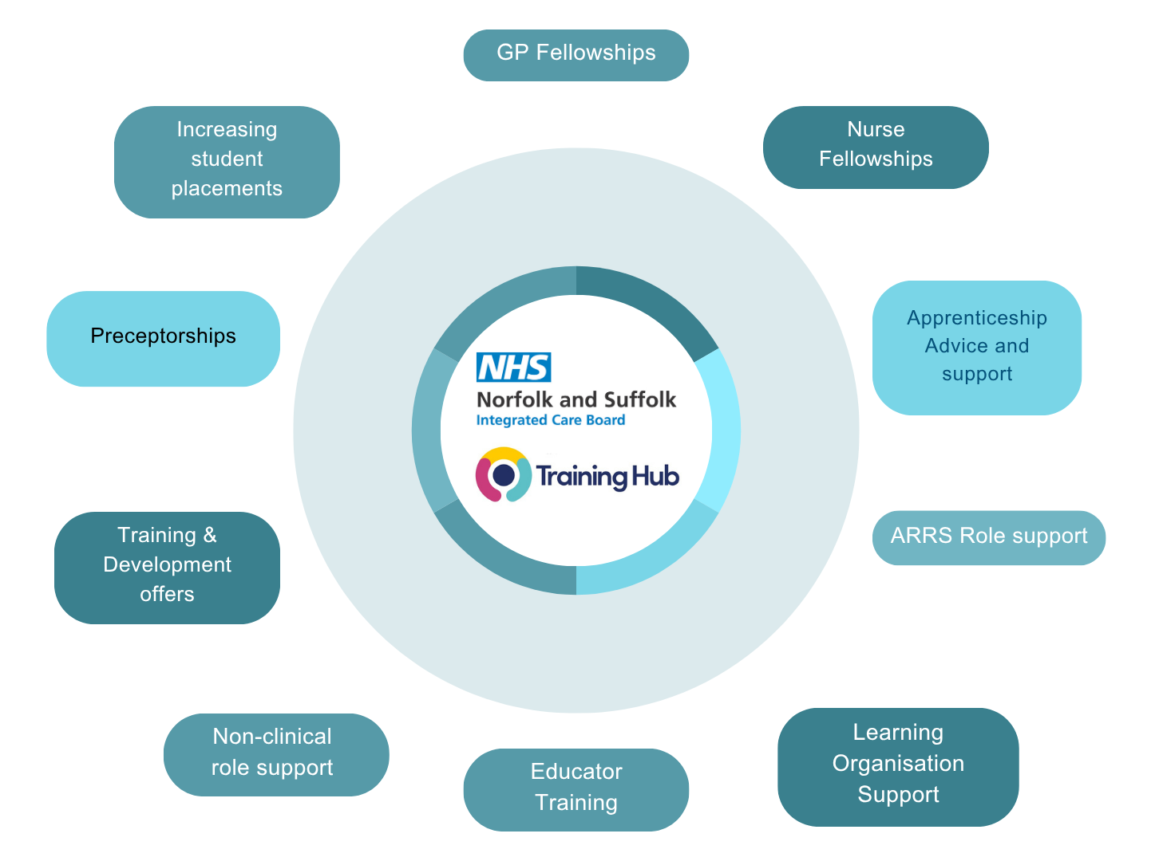
Training Hub Offers
Training opportunities
The Training hub offers a variety of learning opportunities, education and training events including a substantial CPD rolling programme.
For further information on our current Training offers, including a live calendar of events and extensive resources, please visit the following pages:
Training calendar
Resources
E-learning Resources
E-learning platforms
Other offered opportunities
The Training hub also offers a variety of other multi-professional workforce support for general practice. Please see infographic to the right for more information
Further full details on The Training Hub offers please visit our website

Slide 8


GP Support Hub
The GP Support Hub is a supportive way for GPs in Norfolk and Suffolk, to obtain confidential information, advice, support on their careers, personal development, and well-being. It is easy to access, easy to navigate and will help with applications and accessing programmes and support networks.
It also offers wider services such as admin support for revalidation and return-to-work advice.
Further full details on The GP Support Hub please visit

Slide 9

Induction
An effective induction process makes staff feel welcome and helps them settle into their role more quickly.
This Introduction programme is designed to compliment your existing 'local' induction that takes place within your place of work.
It is crucial to ensure that you receive a local induction to help you bond with your team, department and important stakeholders whilst gaining an effective introduction to your own organisation and role.
(NHS England, 2023)

Slide 10
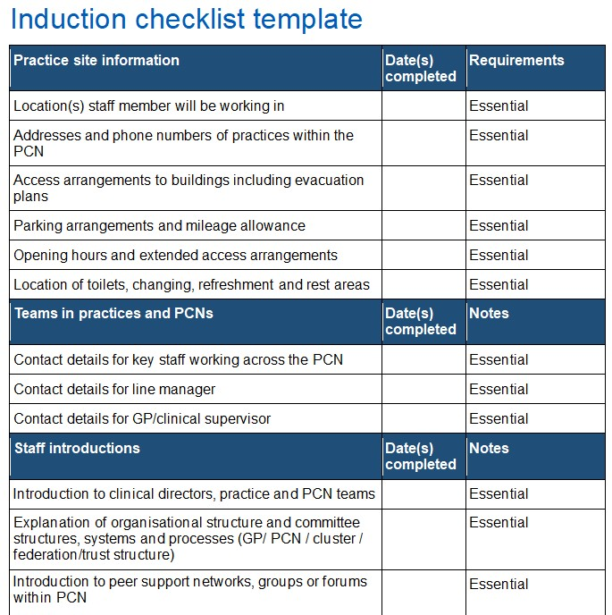
The Importance of Induction
NHSE Example induction checklist
NHSE have created an 'Example induction checklist’ template for multidisciplinary team staff in general practice
This example induction checklist template provides a consistent and comprehensive set of steps to give staff in primary care settings an effective induction, supporting them to integrate and gain confidence in their new roles.
They recommend that primary care organisations may wish to consider using this template as part of their standard induction processes, tailoring the checklist items to suit local needs.
Please note that this template is intended as optional guidance. Practices, PCNs and other employers are responsible for ensuring their staff undergo an appropriate induction to the organisation and their role. Discussions around which is most appropriate for staff and the workplace, must always be agreed with an employer.
Example taken from the full document found here

Slide 11
Induction Examples
Other Example induction templates
There are also profession specific example induction checklists that have been published my several professional bodies.
Please see list below for resources:
Example Link | Produced by
Physiotherapist: First Contact Practitioner Induction checklist | The Chartered Society of Physiotherapy
Pharmacy Example Induction checklist (CPPE) | Centre for Pharmacy Postgraduate Education
General Practice Nursing Induction Template | NHS England
Junior Doctors Induction Example | British Medical Association
Information Governance Induction Checklist example | NHS Norfolk & Suffolk Integrated Care Board

Slide 12
Mandatory Training
Each GP practice is responsible for determining what mandatory and additional training its staff need. They are also responsible for how this is delivered
We understand that across the SNEE region there may be various arrangements for mandatory training completion in general practice.
For further information please see CQC: GP Mythbuster 70: Mandatory Training considerations in general practice.
The CSTF consists of 11 core subjects for England that cover essential skills and knowledge for safe and effective working environments:
Equality, diversity and human rights
Health, safety and welfare
Conflict resolution
Fire safety
Infection prevention and control
Moving and handling
Safeguarding adults
Preventing radicalisation
Safeguarding children
Resuscitation
Information governance.
Skills for Health - Core Skills Training Framework
Core Skills Training Framework – FAQ
The Core Skills Framework (CSTF)
The Core Skills Training Framework (CSTF) was first developed in 2013 and has become widely recognised as the trusted standard for statutory and mandatory training in the health sector.
It helps guide and standardise the focus and the delivery of key statutory and mandatory training skills.
It was developed in collaboration with employers, industry leading experts and professional bodies, such as the Resuscitation Council and the Infection Prevention Society (Skills for Health, 2023).
For further information and learning opportunities, please see:
e-lfh Statutory and Mandatory Training Programme
British Medical Association: Training resource for GP Practice Staff
Core Skills Mapping Tool

Slide 13
NHS E-learning Opportunities
E-learning short for electronic learning, refers to the process of acquiring knowledge and skills through digital resources and technologies. In essence, it encompasses any form of learning that takes place online, whether through interactive courses, virtual classrooms, or mobile apps.
NHS England provides access to two national, complementary learning platforms for the health and care workforce: the elfh Hub and the Learning Hub.
The e-lfh Hub
E-learning for healthcare works in partnership with the NHS and professional bodies to support patient care by providing e-learning to educate and train the health and care workforce. All content is nationally quality assured.
The e-learning programmes are developed and delivered in partnership with professional bodies, including Royal Colleges and associations, NHS organisations, charities and other health and care organisations.
For further information on e-lfh please see here
The Learning Hub
The Learning Hub is a digital platform that provides easy access to a wide range of education and training resources for the health and care workforce.
Users can contribute digital resources (including e-learning, video, audio, images, documents, web links, articles etc.) and search and access the variety of learning resources that have been contributed by organisations and the health and care workforce.
For further information on The NHS Learning Hub please see here
(NHS Learning Hub Support Portal, 2025)

Slide 14
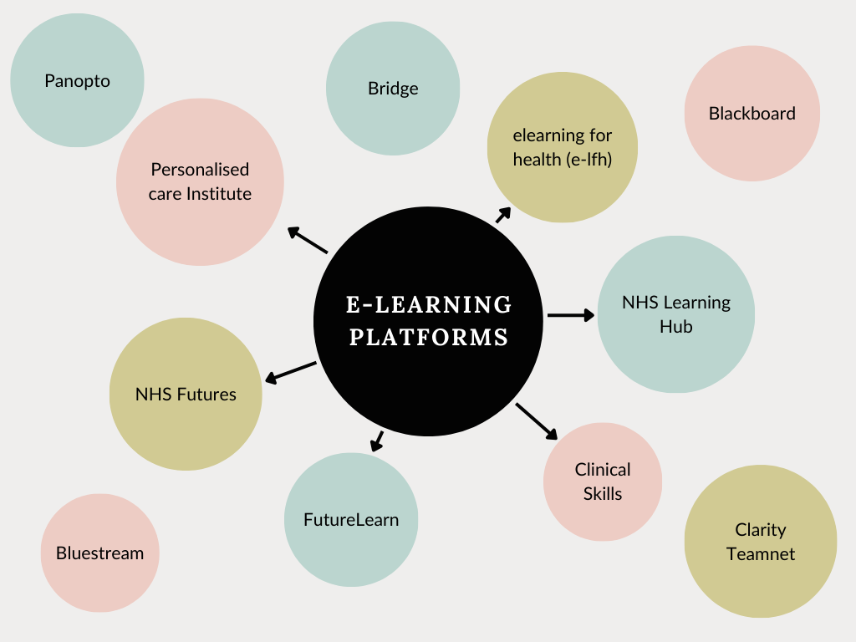
Online Learning Platforms
There are various accessible online learning/training platforms that are available to use.
They all provide trainers, learners and others with information, tools and resources to support and enhance education delivery and management.
Some are free to access, whilst others require a subscription.
Some may also be available via your professional regulatory body.
We would encourage you to please check within your employed organisation which systems may be specifically available for you to access in your current workspace.
This diagram shows examples of some of the online platforms that have been frequently used across the Norfolk, Suffolk and North Essex region - Please note that this is not an exhaustive list.
For further information including links to some of these platforms, please see here

Slide 15
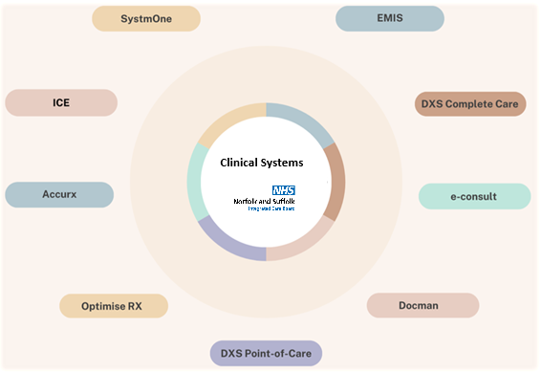
Clinical Systems
Clinical Systems across Norfolk and Suffolk
There are various clinical systems utilised across the SNEE region.
SNEE ICB has collated various information about some of these systems, including access information, user guides, tutorials and webinars. Please access these here
Please note: you may have to register an account to view this information.
For further information regarding systems not listed on the SNEE ICB website, please contact the companies direct for user guides and training offers.

Slide 16
The NHS App
As part of the NHS Long Term Plan to increase the range of digital health tools and services, the NHS app extends to everyone as a new digital 'front door’.
It is designed to give people secure digital access to their own medical records, find trusted information about their health online; allow patients to conveniently book appointments and view test results online. In time it will also provide medical advice and consultations securely (NHS England, 2024).
There are various national and local resources available to help with implementation and management of the app both for patients and GP practices. Please see the following resources for further information and support:
Example Link | Produced by
NHS App Resources | NHS England
NHS App Walk Through Videos | NHS England
NHS Promotional Toolkit | NHS England
NHS App Home page (for patients) | NHS England

Slide 17

NHS and Artificial Intelligence (AI)
Artificial Intelligence (AI) has the potential to make a significant difference in health and care settings. We’re already seeing numerous applications of AI technology, and more work is underway to fully harness its benefits and use AI safely and ethically at scale. AI as a specialised technology differs in many ways to other medtech technologies. Addressing these AI considerations is the focus of the NHS England AI team (NHS England, 2025).
Artificial intelligence (AI) and machine learning
The NHS England AI Team aims to lead the NHS in harnessing AI innovations to deploy them in an ethical, efficient, and responsible manner that delivers enhanced health outcomes and system efficiencies, while upholding transparency, trust, and patient safety.
They have created an AI knowledge repository to enable the responsible adoption of AI in the NHS by providing a suite of resources for all those working within healthcare to access.
It is predicted that general practice will be one of the most affected workforce groups in the NHS. (NHS England, 2025)
Further information and support
For further information and support in regard to AI in general practice please see NHS Digital guidance here
ICB Digital and IT team for further local support and guidance : Norfolk & Suffolk: nwicb.digital@nhs.net.
Please also seek guidance from your local Data Protection Officers for your organisation.

Slide 18
Personalised Care Institute
In September 2020, NHSE launched the Personalised Care Institute. The PCI institute was set up to:
- set quality standards for training
- support the development of training programmes for the current workforce
- support the development of training programmes for the new roles identified within primary care networks
The institute is working closely with royal colleges and key membership organisations to take a coordinated approach to training, signposting to high quality ‘accredited’ training available across England (NHSE, 2024)
The PCI is easily accessible is free to use.
For further information about the Personalised Care Institute please access here
The Personalised care institute offer various learning opportunities including:
- e-learning
- accredited training
- Webinars
- Podcasts
- Virtual patient avatars
Core Skills
Shared Decision making
Personalised care and Support Planning
Remote consultations
Person Centred Approaches
Making Every Contact Count
Frailty

Slide 19

Personal Development
Portfolio or E-portfolio
Career Development and progression
A portfolio allows you to store and record a collection of evidence to demonstrate the skills you have developed. It is useful for:
keeping all your relevant documents together
reflecting on your learning
recording your career planning in your personal development plan (PDP)
preparing for applications and interviews
For more information on Personal development resources please visit:
NHS Medical Appraisal
NHS Appraisals and KSF
The NHS provides opportunities for staff to extend their skills and take on new responsibilities.
A career in the NHS means you can expect an annual personal development review (appraisal) and plan to support your career progression. It will give you the opportunity to identify any training and development needs with your manager, making it easier to progress through the NHS bands.
If you work in a role that requires registration with a regulatory body in order to practise, such as nursing, then you'll usually be required to keep your skills and knowledge up to date through CPD.
You can find out what the requirements are from the relevant regulatory body responsible for your profession. Professional bodies provide advice, support and opportunities to enable you to maintain your CPD. The Chartered Institute of Personnel and Development has more information about CPD, including tools to help you record your CPD.
(NHS Health Careers, 2025)

Slide 20
Supervision
Supervision
Supervision is a process of professional learning and development that enables individuals to reflect on and develop their knowledge, skills and competence, through regular support from another professional.
Supervision can have different forms and functions, and a number of terms are used to describe these:
Clinic/practice supervision:
Day-to-day support provided by a named/duty senior/more experienced clinician for issues arising in the practice
Educational supervision:
Supports learning and enables learners to achieve proficiency.
Clinical/professional supervision:
Regular support from a named senior/experienced clinician/practitioner to promote high clinical standards and develop professional expertise.
For further Supervision Guidance for primary care network multidisciplinary teams please see here

Slide 21

Supervisors/Educators
Educators
In the context of ever-increasing demands on the NHS, education and training are increasingly important because of the inextricable link between securing a future workforce, retaining our current workforce, and maximising productivity of the current workforce.
Delivering our future workforce is ultimately dependent on a sustainable and high-quality educator workforce to support education and training, both in practice and in academic settings.
NHS England have created an ‘Educator Workforce Strategy’ which aims to set out actions that will lead to sufficient capacity and quality of educators to allow the growth in healthcare workforce that is needed to deliver care, now and in the future.
NHS Educator Workforce Strategy
Safe Learning Charter
The Safe Learning Environment Charter supports the development of positive safety cultures and continuous learning across all learning environments in the NHS. It is underpinned by principles of equality, diversity, and inclusion.
The Charter is designed for learners and those responsible for supporting placement learning across all learning environments and all professions within them.
NHS Safe Learning Environment Charter
Links for further information on Educators:
Nurse and Midwife Educators Career Framework
AHP Educator Career Framework
NHSE Quality Framework
Educator Training Resource (e-lfh)

Slide 22
Module completed
Introduction to Norfolk and Suffolk primary care

