Slide 1


Primary Care Induction Programme
The NHS and Primary Care

Slide 2

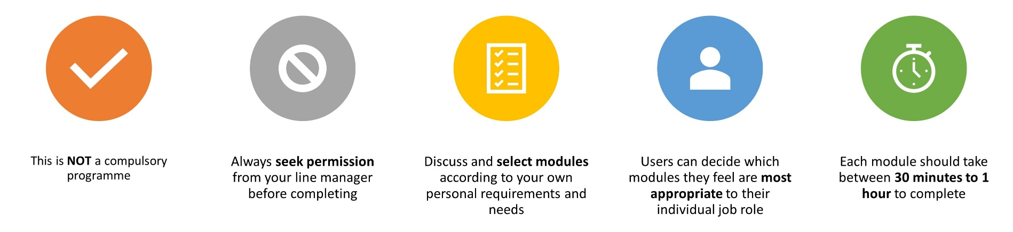
Important Information
Slides are interactive and require the user to click through information using a mouse or space bar.
To view videos in a larger format or full screen, they can be viewed externally at source. Please click the source title e.g. YouTube in bottom left hand corner, and it will take you to a full screen to view.
For Subtitles and closed captions, please click the ‘CC’ logo at the bottom of the video on the left-hand side once launched.
Please note:
The information included in this programme is correct at time of creation. Whilst we have made our best endeavours to make sure the information and materials included in this programme are from reputable sources, if you feel something has been missed or find any errors, please contact us as soon as possible. Thank you.
TheTraining Hub
training.hub@snee.nhs.uk

Slide 3
The NHS
The NHS is a complex system, which can sometimes make it difficult to understand – especially working out who is responsible for what. It’s made up of a wide range of different organisations with different roles, responsibilities, and specialities. These organisations provide a variety of services and support to patients and carers.
Primary care is often the first point of contact for people in need of healthcare, provided by professionals such as GPs, dentists, pharmacists and. Primary Care is the ‘front door’ of the NHS.
Secondary care, sometimes referred to as ‘hospital and community care’ can either be planned (elective) care or urgent and emergency care.
Tertiary care refers to highly specialised treatment such as neurosurgery, transplants, and secure forensic mental health services.
For further explanation of the healthcare ecosystem, please visit here

Slide 4
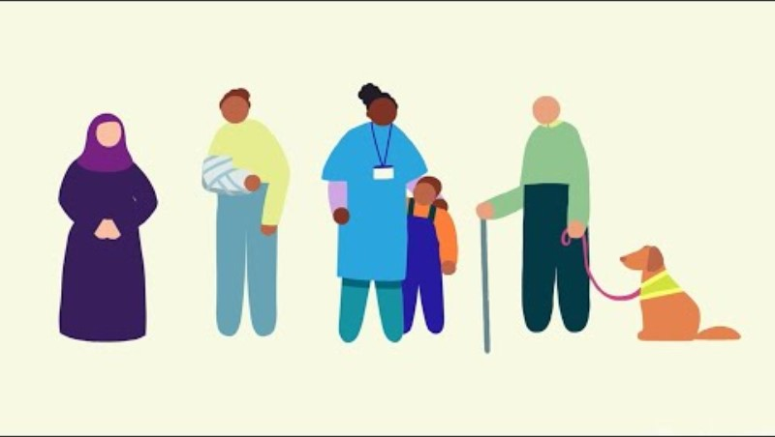
VIDEO: How does the NHS in England work and how is it changing?
VIDEO: How does the NHS in England work and how is it changing (NHSE, 2023) Click image to access

Slide 5
NHS Structure
NHS constitutional values
Working together for patients
Respect and dignity
Commitment to quality of care
Compassion
Improving lives
Everyone counts
Further details of the NHS constitutional values can be found here

Slide 6
What is an Integrated Care System (ICS)?
Introduction to Integrated care Systems
Integrated care systems (ICSs) are partnerships that bring together NHS organisations, local authorities, and others to take collective responsibility for planning services, improving health, and reducing inequalities across geographical areas.
ICSs are made up of two key parts:
An integrated care partnership (ICP) - a statutory committee bringing together a broad set of system partners including local government, the Voluntary, Community and Social Enterprise (VCSE) sector, NHS organisations and others, to develop a health and care strategy for the area.
An integrated care board (ICB) - which joins up all parts of the health and care system including GPs, acute, community, and social care services, as well as physical and mental health services.
For further information on Integrated care systems, please click here
⚠️ Please note: The NHS is currently undergoing significant structural change. In March 2025, the government proposed plans to abolish NHS England and merge its functions into the Department of Health and Social Care (DHSC) by March 2027. The number of ICBs is also being reduced through mergers. The information on this slide reflects the current structure; implementation timelines and impacts vary by system; your local team will be able to tell you how this affects your area.

Slide 7

What is an Integrated Care System (ICS)?
Place based partnerships
are made up of NHS organisations, local councils, community and voluntary organisations such as charities, and other community partners with a role in supporting the health and wellbeing of the local population.
Place-based partnerships cover a smaller area than an ICS, such as a town or borough. They involve organisations including GP practices, pharmacies, social care, voluntary groups, and the local authority working together to improve services and use resources more effectively.
For further information on place-based partnerships, please click here
Provider Collaboratives
where two or more health and care organisations formally agree to work together at scale.
They may mutually aid each other in order to be more efficient. There can be any number of provider collaboratives within each ICS, and provider collaboratives may consist of organisations from different ICS footprints in some cases.
For example, organisations within a community health and care collaborative may collaborate on treatment plans in order to provide better outcomes for people using their services.
For further information on provider collaboratives, please click here

Slide 8


Your Local Integrated Care System
From 1 April 2026, the Suffolk and North East Essex Integrated Care System was dissolved and replaced by two new systems:
NHS Norfolk and Suffolk ICB
Covering the Suffolk area
(including Ipswich, East Suffolk
and West Suffolk)
NHS Essex ICB
Covering the North Essex area
These new ICBs have taken on the functions previously held by SNEE ICB, continuing to plan and commission health and care services for the local population in partnership with local authorities, NHS providers, and voluntary sector organisations.
For further information on NHS Norfolk and Suffolk ICB, please see here. For further information on NHS Essex ICB, please see here

Slide 9
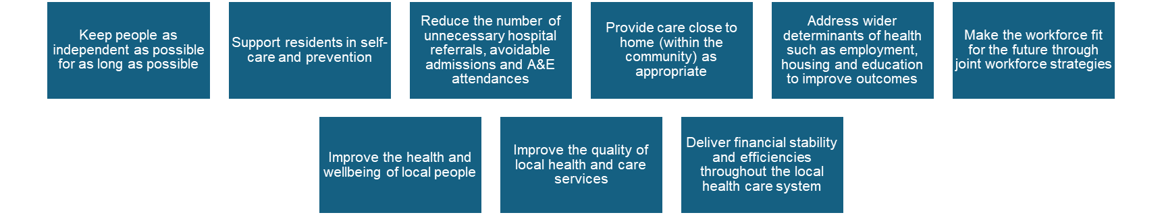
What is an ICB?
Introduction to Integrated Care Boards
An Integrated Care Board (ICB) is the statutory NHS body responsible for planning and buying (commissioning) health care services for its local population. ICBs bring together NHS organisations, GP practices, and other partners to improve health outcomes and reduce inequalities.
Integrated care boards (ICBs) replaced clinical commissioning groups (CCGs) in the NHS in England from 1 July 2022.
The main aims of the ICB are to:
⚠️ The ICB landscape is changing. In 2025, the government announced that the number of ICBs in England would be reduced from 42, with many merging into larger organisations. ICBs are also required to reduce their running costs by 50% and are refocusing on their core role as strategic commissioners. Some functions previously held by ICBs — including aspects of primary care — are expected to move to new neighbourhood-level providers over time. implementation timelines and impacts vary by system; your local team will be able to tell you how this affects your area.

Slide 10


Local NHS ICB’s
From 1 April 2026, the NHS Norfolk and Suffolk ICB took on commissioning responsibilities for the Suffolk population, replacing the former Suffolk and North east Essex ICB for this area.
You can read more about NHS Norfolk & Suffolk Integrated Care Board here
From 1 April 2026, the NHS Essex ICB took on commissioning responsibilities for the North East Essex population, replacing the former Suffolk and North East Essex ICB for this area.
You can read more about NHS Essex Integrated Care Board here
Both ICB’s plan and buy healthcare services for their region's population, working with local authorities, NHS providers, and other partners.

Slide 11




Introduction to Primary care
Primary Care services provide the first point of contact in the healthcare system, acting as the ‘front door’ of the NHS. Primary Care includes General Practice, Community Pharmacy, Dental, and Optometry Services (NHS England).
For further information about primary care, please click here

Slide 12
What are Primary Care Networks?
Working together at neighbourhood level
Primary Care Networks (PCNs) bring together GP practices and other primary care services, such as community pharmacy, to work at scale and provide a wider range of services at neighbourhood level.
PCNs typically serve populations of 30,000 to 50,000 people and are aligned with Integrated Neighbourhood Teams — multidisciplinary teams that bring together professionals from across health, social care, and the voluntary and community sector. NHS England
PCNs are funded through the Direct Enhanced Service (DES), which enables them to employ a wider range of staff roles than individual practices could support — for example, first contact physiotherapists, social prescribing link workers, and care coordinators.
PCNs are focused on service delivery, rather than on the planning and funding of services — which remain the responsibility of Integrated Care Boards (ICBs).
Where are PCNs heading?
The focus of PCNs is evolving — moving from at-scale provision of primary care services towards wider neighbourhood health. The NHS Long-Term Plan places clear emphasis on neighbourhood health services, with primary care at the heart, and 40+ neighbourhood health pilots were announced in 2025.
(Based on 'Primary Care Networks Explained', The King's Fund (updated 2025). www.kingsfund.org.uk)

Slide 13
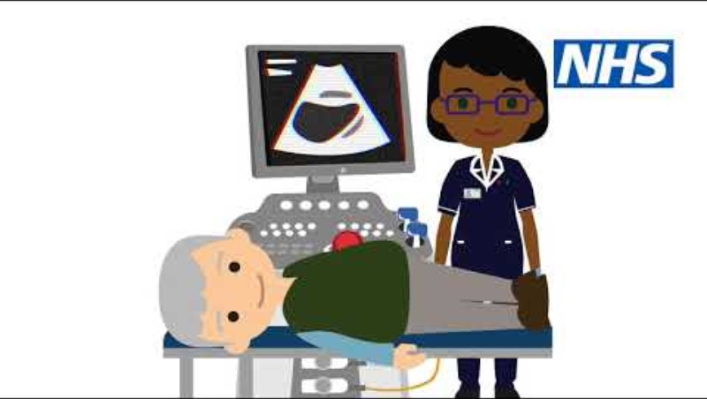
VIDEO: Primary care Networks Animation
VIDEO: Primary care Networks Animation (NHSE, 2019) Click image to access

Slide 14
Integrated Neighbourhood Teams (INTs)
Integrated Neighbourhood Teams & Neighbourhood Health
Integrated Neighbourhood Teams (INTs) bring together professionals from across health, social care, and the voluntary sector to provide joined-up care for a defined local population. Core members typically include community services, social care, and community mental health, with representation from across ICS partner agencies.
Neighbourhood Health — the future direction The NHS 10 Year Health Plan (July 2025) places neighbourhood health at the heart of NHS reform. The plan aims to shift care from hospitals into communities through the development of Neighbourhood Health Centres — local hubs co-locating GPs, community services, diagnostics, and mental health support, open at least 12 hours a day, six days a week.
These centres will offer a wide range of services under one roof, including preventative care, specialist clinics, pharmacy, physiotherapy, and wider support such as debt advice and employment services.
40+ pilot areas were announced in September 2025, with plans to roll out to every community in England, starting with areas where healthy life expectancy is lowest.
INTs and Primary Care Networks are being asked to align their boundaries with emerging neighbourhood health areas — this is an evolving area you will hear more about in your role.

Slide 15

What are GP Federations?
GP federations are groups of primary care providers, which form a single organisational entity and work together as economies of scale to deliver services for their combined patient communities (NHS Confederation, 2021).
There are many GP federations across England (NHSE, 2026).

Slide 16
Suffolk GP Federation
GP Suffolk Federation is a not-for-profit organisation owned by 57 GP practices.
Their aim is to:
‘find innovative solutions to the challenges currently faced by the NHS, while at the same time protecting the interests of general practice and ensuring that patients continue to receive the very best care.’
For further information please see: https://suffolkfed.org.uk/.
Click above for video

Slide 17
GP Primary Choice
GP Primary Choice is a primary care provider company based in North east Essex owned by 32 GP Practices in the locality.
Values:
  Locally run to meet local needs;
  Securing quality for our patients;
  Trusted and based on patient preference;
  Sustainable and viable
Aims:
  Supporting Primary Care to be sustainable
  To reduce Health Inequalities
  To improve access to services within the local communities
For further information please visit: https://www.gpprimarychoice.co.uk/

Slide 18
Norfolk Primary Care CIC
Norfolk Primary care is Community Interest Company, proudly owned by member GP practices across Norfolk and Waveney.
They provide innovative, at-scale services designed to support the strength, resilience, and sustainability of primary care. By working closely with our member practices, they help deliver high-quality care to local communities while driving improvements through practical, forward-thinking solutions.
For further information please visit: https://norfolkprimarycare.com/

Slide 19
How Patients Access Services
How do patients access primary care?
Patients use a range of routes, which influence workload and demand:
GP practice (phone, online, in person)
NHS App and digital consultation tools
Community Pharmacy (minor illness, Pharmacy First)
NHS 111 and urgent care services
What this means for staff
Patients may arrive through different routes with different expectations
Not all patients need to see a GP
You may need to signpost or redirect appropriately
Demand is managed through triage and prioritisation

Slide 20
Modern General Practice
How general practice has evolved:
General practice has changed significantly to meet increasing demand and complexity. General Practice is no longer GP only – it is a team-based model of care:
Growing patient need and complexity
Workforce diversification
(multidisciplinary teams)
New models of access
(triage, digital, Pharmacy First)
Greater focus on prevention and population health

Slide 21
The Modern General Practice Model
Multidisciplinary teams (MDT)
Triage and care navigation
Digital access alongside traditional routes
Working at scale (PCNs, federations)
Closer integration with community and social care
You will work as part of a wider team
Roles are more specialised and structured
Collaboration across services is essential
Supporting appropriate access and flow is everyone’s responsibility

Slide 22

Module completed
The NHS and Primary care

