Slide 1


Primary care induction Programme
Introduction to Primary care
Multi-disciplinary Teams

Slide 2

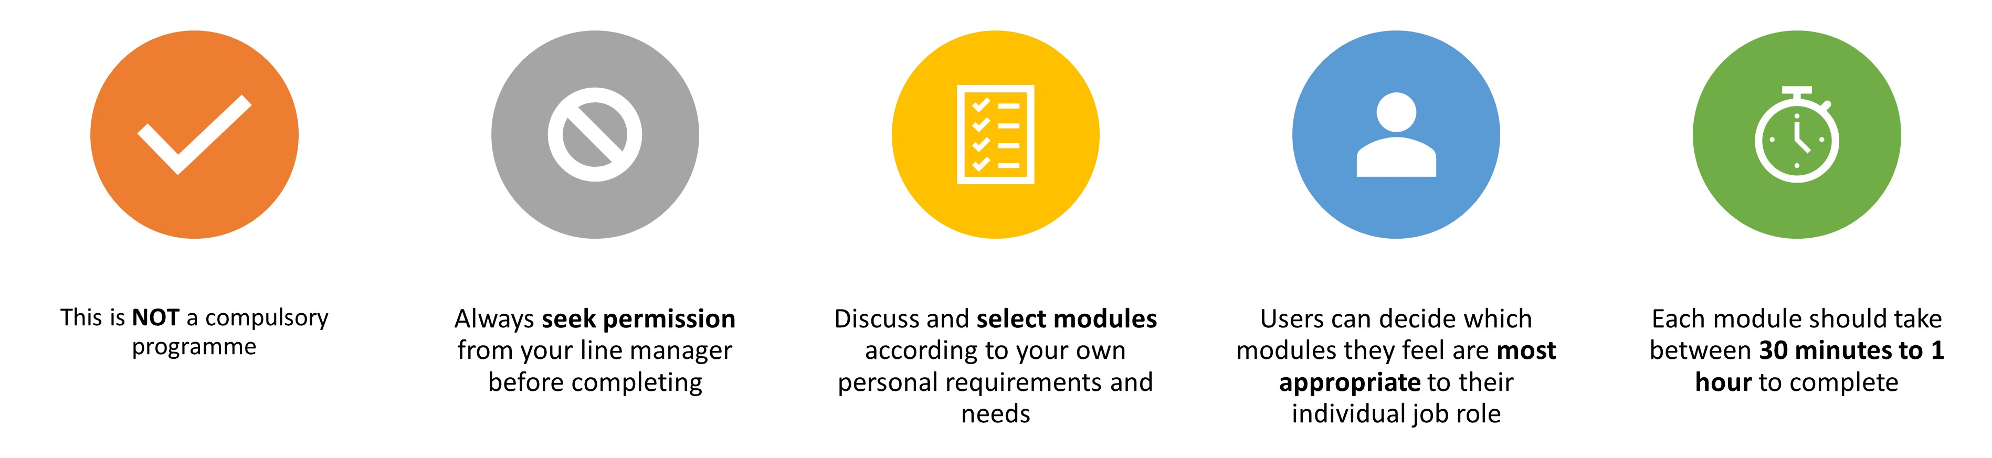
Important Information
Slides are interactive and require the user to click through information using a mouse or space bar.
To view videos in a larger format or full screen, they can be viewed externally at source. Please click the source title e.g. YouTube in bottom left hand corner, and it will take you to a full screen to view.
For Subtitles and closed captions, please click the ‘CC’ logo at the bottom of the video on the left-hand side once launched.
Please note:
The information included in this programme is correct at time of creation. Whilst we have made our best endeavours to make sure the information and materials included in this programme are from reputable sources, if you feel something has been missed or find any errors, please contact us as soon as possible. Thank you.
Suffolk and North east Essex Training Hub
training.hub@snee.nhs.uk

Slide 3
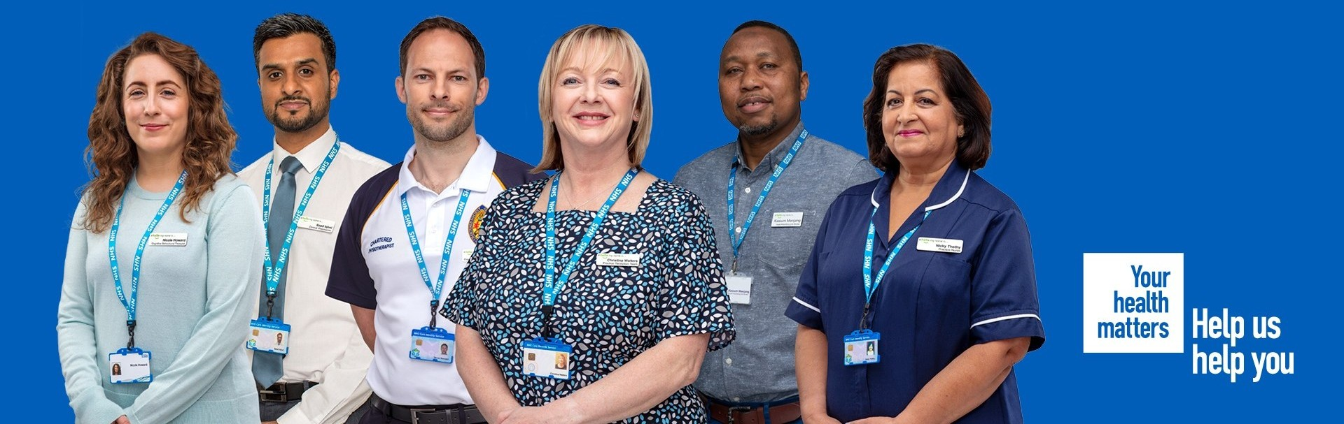
Introduction to Primary care Multi-disciplinary teams
Working in primary care offers a rewarding and varied career; with a broad mix of roles in lots of different settings, a strong sense of team spirit and the opportunity to build meaningful connections with the local community.
Working at the forefront of patient care, primary care teams are able to work with patients on a one-to-one basis, often over a prolonged period of time, creating lasting bonds with patients and their family members or carers (gmprimarycarecareers.org.uk, 2023) Add new NHS Primary care team image to page - Your Health Matters, Help us Help you image.

Slide 4
Expanding our workforce
Multi-professional Team working
Expanding practice teams brings the opportunity to embed new skills into primary care, widens the range of services offered by general practice and works towards resolving some of the challenges currently faced in primary care.
We know that general practice across the UK is facing change, with significant GP workforce shortages. (RCGP, 2023)
As part of the vison for the NHS Long Term Plan, the implementation of the ARRS scheme is intended to grow additional capacity in primary care through new multidisciplinary roles (NHSE, 2019)
Pharmacy Technician
Physiotherapist
Paramedic
GP
Nurse
Reception Team
Clinical Pharmacist
Physician Assistant
Mental Health therapist
Occupational Therapist
Dietitian
Personalised care roles
Advanced Practitioners
Healthcare Assistant
Further information can be found here

Slide 5
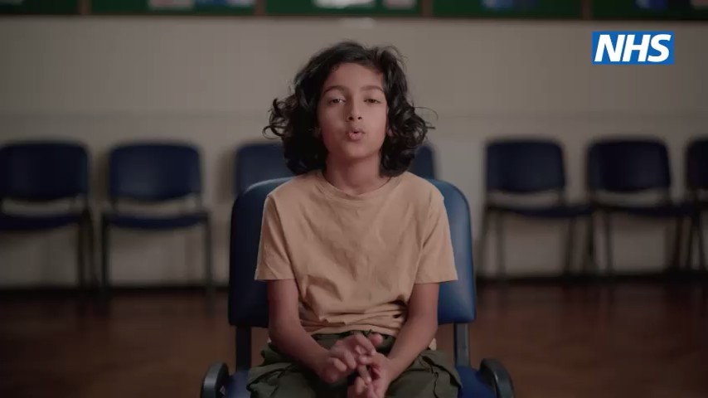
VIDEO:NHSE General Practice Team Campaign
Video: NHSE GP Hero Access PR Film (NHSE Campaigns 2023) Click image to access

Slide 6
Roles in Primary Care

Slide 7
GP Roles
General Practitioner (GP)
GP's are experts in their patients. They provide the first point of contact with the NHS for most people in their communities - there are approximately 1 million GP consultations in the UK every day. GPs are vital to their local community and contribute hugely to keeping the nation healthy. They deal with a wide range of medical conditions and will treat patients throughout their lives. (Royal College of General Practitioners, 2023).
GP Partner
GP's are experts in their patients. They provide the first point of contact with the NHS for most people in their communities - there are approximately 1 million GP consultations in the UK every day. GPs are vital to their local community and contribute hugely to keeping the nation healthy. They deal with a wide range of medical conditions and will treat patients throughout their lives. (Royal College of General Practitioners, 2023).
Salaried GP
An NHS salaried GP is a fully-qualified GP who is employed by a practice (under contract) or an out-of-hours provider. (British Medical Association 2022). For more information (add link to BMA)
For more information about developing a career in General Practice, including the career pathway, please visit here

Slide 8
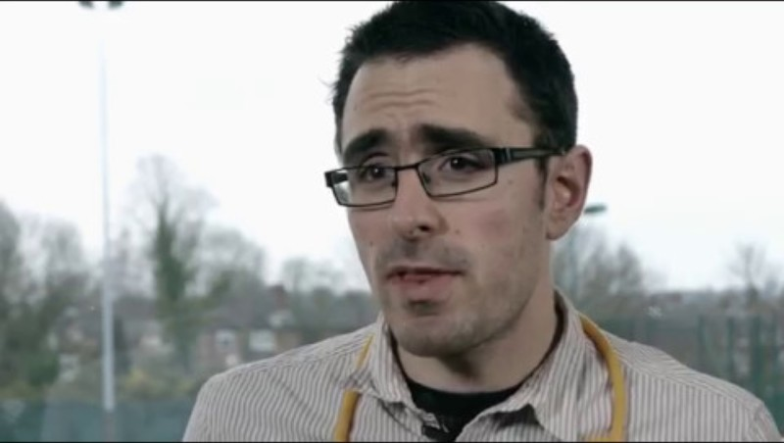
VIDEO: A Career in General Practice (GP)
Video: A Career in general practice (NHSE Campaigns 2018) Click image to access

Slide 9
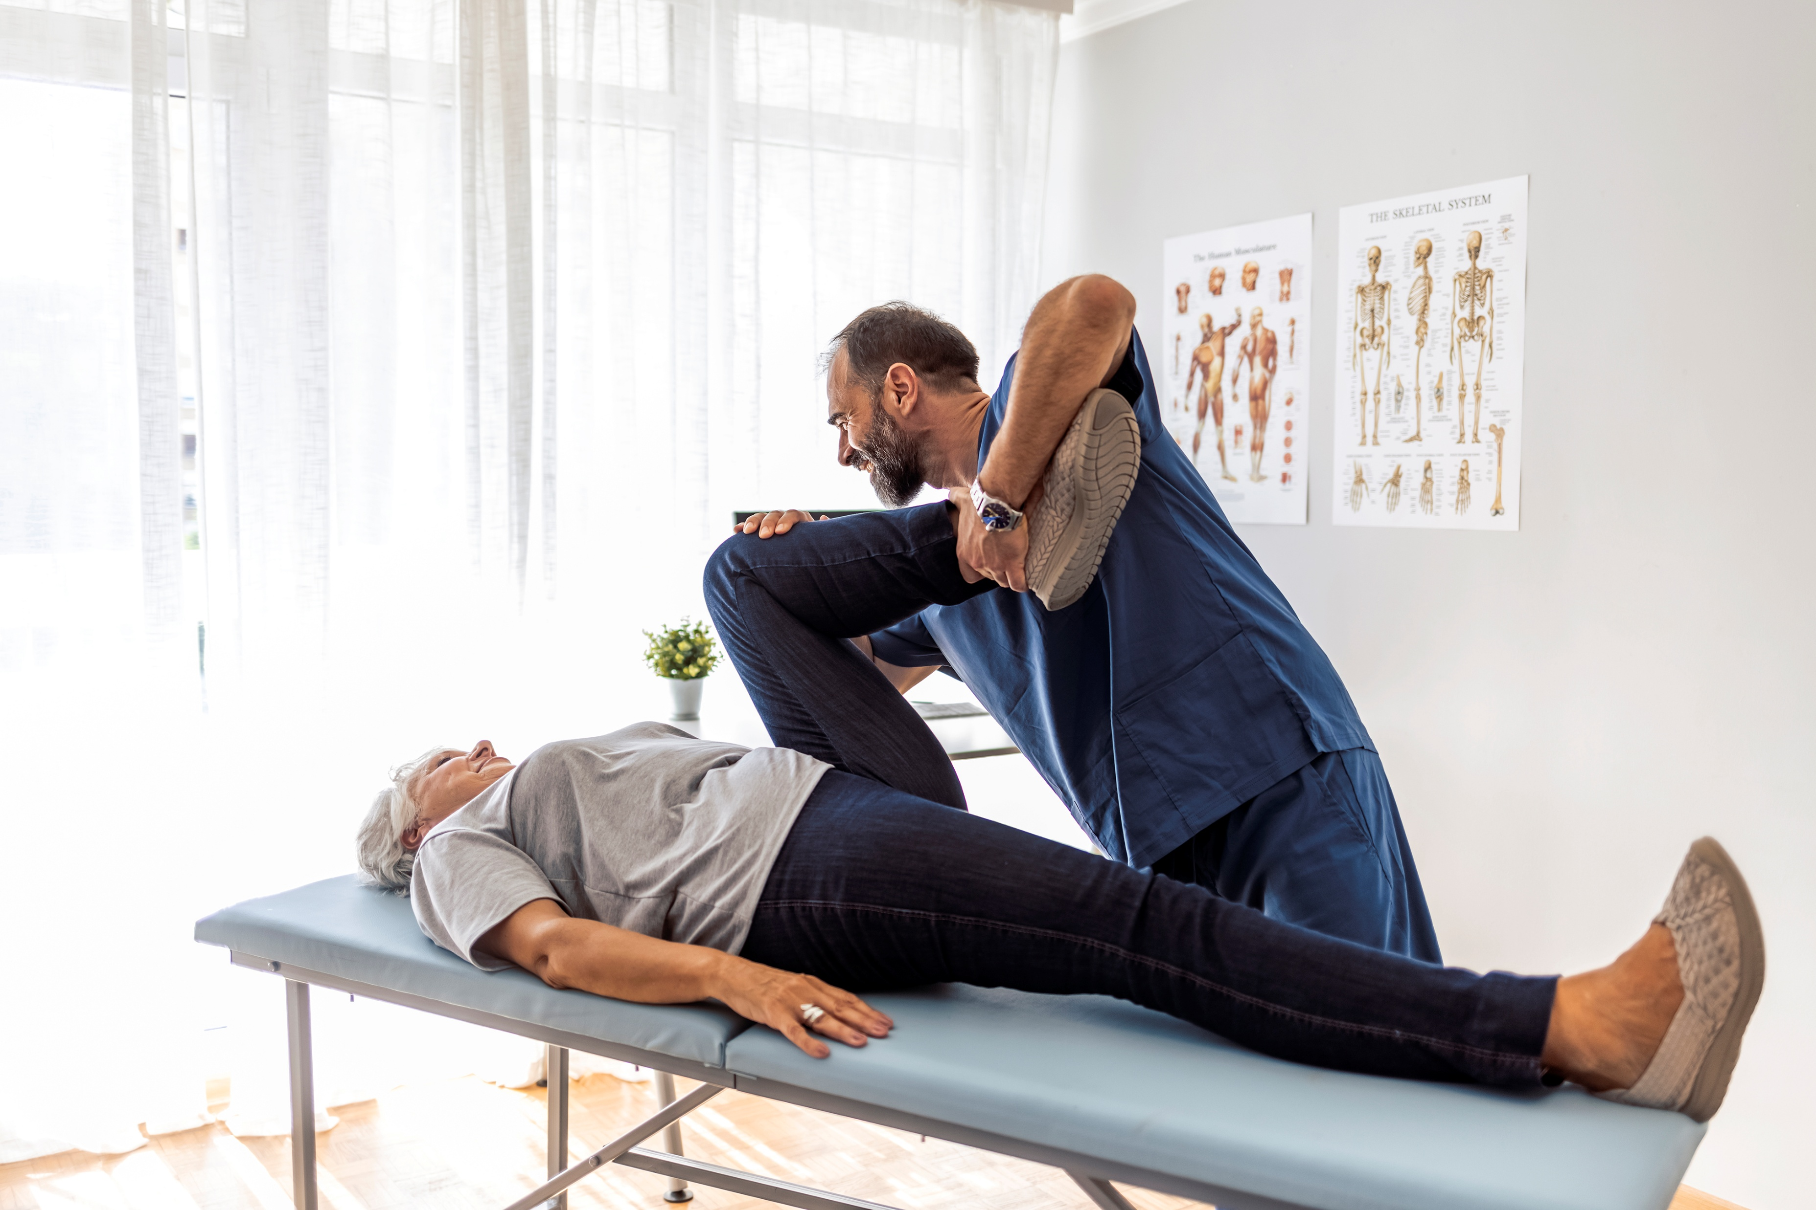
Allied Health Professional Roles
Physiotherapist – First Contact Practitioner
First Contact Practitioner (FCP) Physiotherapists are physiotherapists based in GP surgeries with an expertise in the assessment and management of musculoskeletal conditions.
An FCP Physiotherapist is a diagnostic clinician working in Primary Care at the top of their clinical scope of practice. The development of FCP Physiotherapy services across the UK allows people with musculoskeletal (MSK) conditions to access MSK physiotherapy expertise at the start of the pathway, ensuring timely access to diagnosis, early management and onward referral if necessary. This benefits patients, primary care and the wider MSK system. Patients that may be eligible for an appointment with an FCP Physiotherapist may have the following problems:
Soft tissue injuries, sprains, strains or sports injuries
Arthritis – any joint
Possible problems with muscles, ligaments, tendons or bone, eg tennis elbow, carpal tunnel syndrome, ankle sprains
Spinal pain including lower back pain, mid-back pain and neck pain
Spinal-related pain in arms or legs, including nerve symptoms, eg pins and needles or numbness
Changes to walking
Post-orthopaedic surgery
The physiotherapist will:
Assess and diagnose what’s happening
Give expert advice on how best to manage the condition
Refer onto specialist services if necessary (Chartered Society of Physiotherapy, 2023 and Roadmap to Practice, 2021). For more information (add CSP page link and Roadmap to practice link). Add video at end of information please.
For more information about FCP’s in General Practice, including the FCP career pathway, please visit here

Slide 10
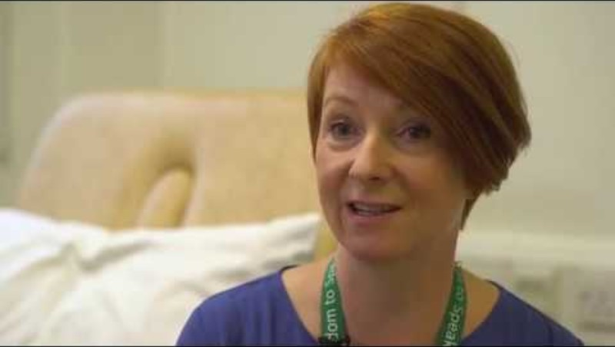
VIDEO: First contact practitioners in musculoskeletal services
Video: First contact practitioners in musculoskeletal services (NHSE, 2020) Click image to access

Slide 11
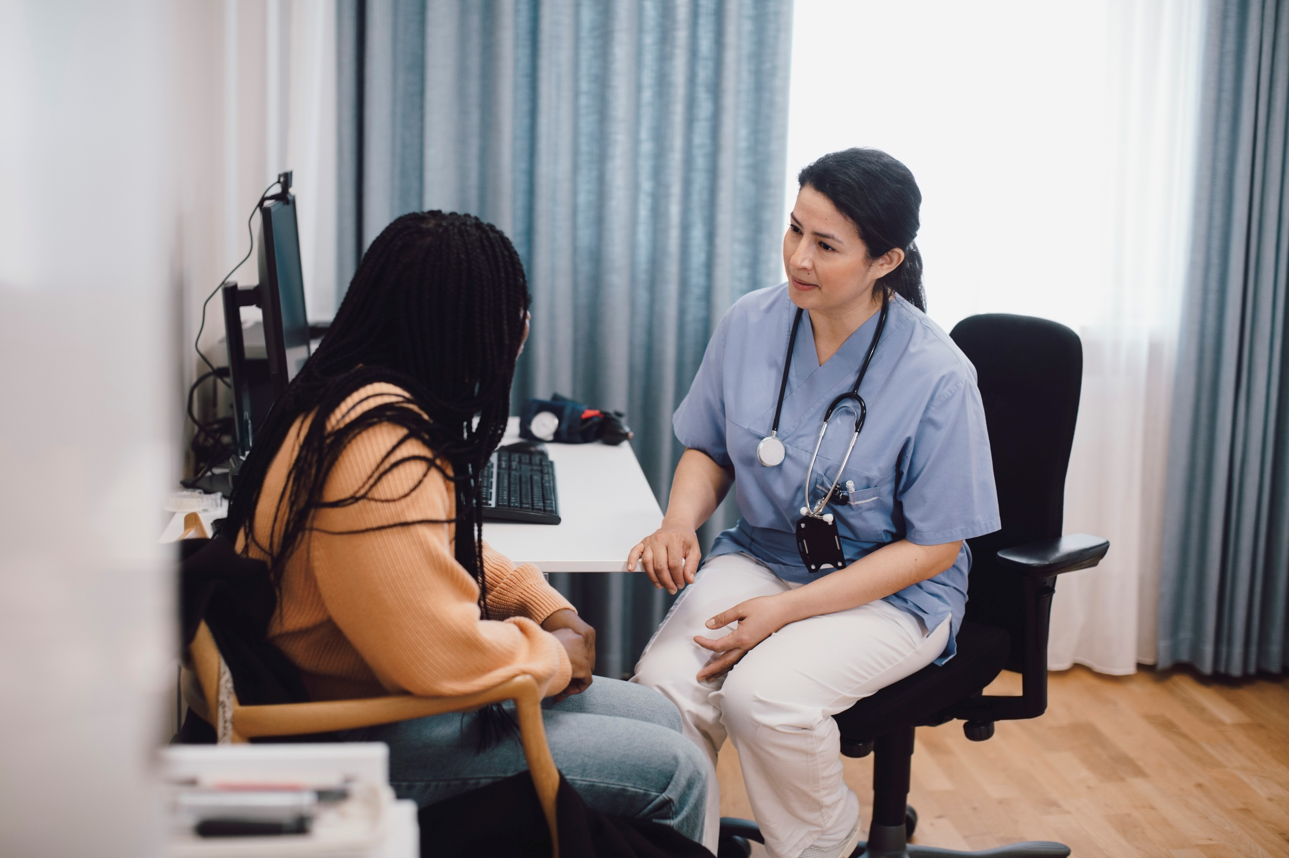
Allied Health Professional Roles
Paramedic – First Contact Practitioner
First Contact Practitioner (FCP) Paramedics are autonomous, diagnostic clinicians with experience in handling undifferentiated and unpredictable cases; conducting an array of clinical assessment, diagnostic, and treatment activities; and directing and signposting care.
They are at the top of their clinical scope of practice . As generalists, they can effectively use the medical / biopsychosocial model to assess, examine, treat, and manage patients of all ages, with a variety of undifferentiated and chronic conditions.
The paramedic may:
Triage patients
Carry out telephone and face-to-face consultations
Conduct home visits.
Refer patients to GPs for the management of presentations and pharmacology outside their scope of practice
(HEE 'A Roadmap to Practice', 2022).
For more information about Paramedic FCP’s in General Practice, including the FCP career pathway, please visit here

Slide 12
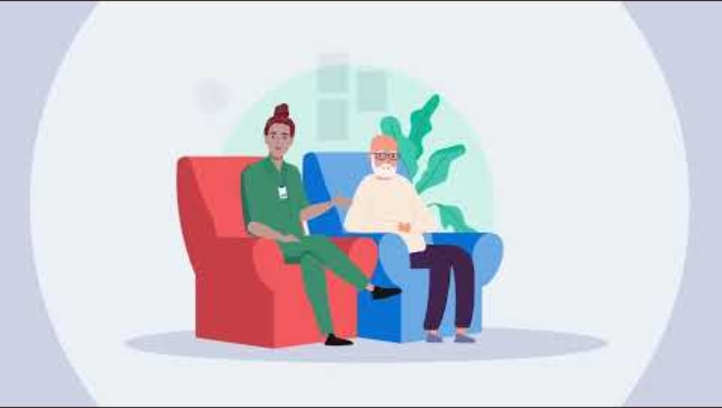
VIDEO: Meet our paramedic - working alongside GPs to meet patients' healthcare needs.
Video: Meet our paramedic - working alongside GPs to meet patients' healthcare needs. (NHSE, 2023) Click image to access

Slide 13


Allied Health Professional Roles
Podiatrist - First Contact Practitioner
First Contact Practitioner (FCP) podiatrists usually work from GP surgeries and clinics within primary care and can see patients with lower limb conditions without them having seen the GP first. They demonstrate an extended level of skills, training and experience.
FCP Podiatrists use specialist knowledge of lower limb health across a broad range of clinical presentations spanning musculoskeletal, cardiovascular, neurological, dermatological, or age-related conditions.
The podiatrist will:
provide personalised self-management advice
Formulate initial treatment plans
Facilitate shared decision-making
Initiate appropriate tests and investigations
Initiate a referral to other services
(Royal College of Podiatry, 2023)
For more information about FCP Podiatrist in General Practice, including the FCP career pathway, please visit here

Slide 14
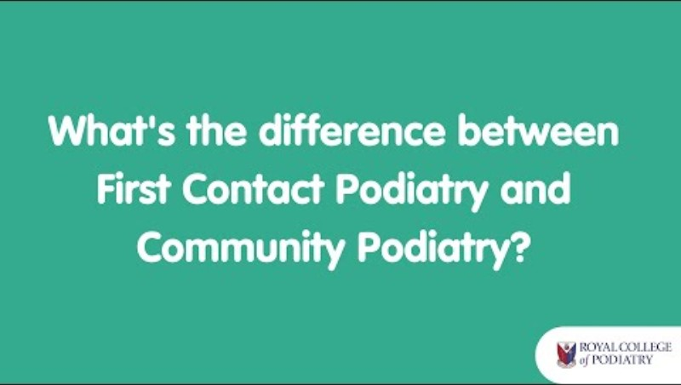
VIDEO: How is First Contact Podiatry different to community podiatry?
Video: How is First Contact Podiatry different to community podiatry? (Royal College of Podiatry, 2024) Click image to access

Slide 15

Allied Health Professional Roles
Occupational therapist - First Contact Practitioner
First Contact Practitioner (FCP) Occupational therapists are working at an advanced level in their scope of practice.
Occupational therapy, change people’s lives. But to date, few GP practices have occupational therapists, and this needs to change fast.
FCP Occupational therapists provide diverse expertise to primary care teams helping patients get fast access to the right care.
Using health population approaches, they offer bespoke services for specific patient groups.
Their interventions are proactive and preventative to keep patients functioning and active.
This Photo by Unknown Author is licensed under CC BY-ND
The Occupational Therapist will:
help target the biggest causes of reduced life expectancy.
Work holistically across the life span for patients with physical, mental and social needs
(Royal College of Occupational Therapists, 2023)
For more information about FCP Occupational therapist in General Practice, including the FCP career pathway, please visit RCOT and NHSE

Slide 16
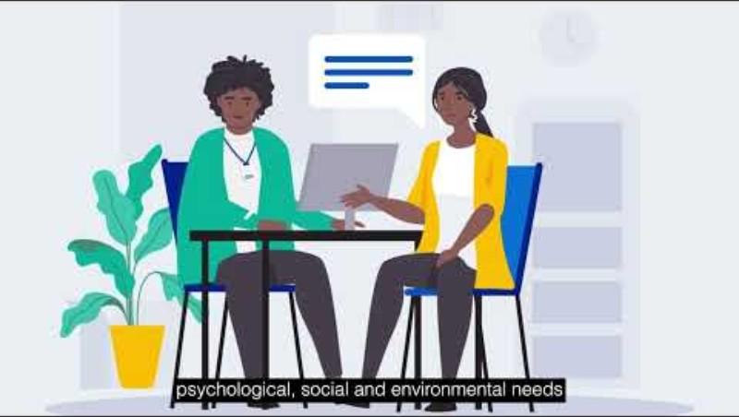
VIDEO: Meet our occupational therapist - working alongside GPs to meet patients' healthcare needs.
Video: Meet our occupational therapist - working alongside GPs to meet patients' healthcare needs (NHSE, 2023) .Click image to access

Slide 17


Allied Health Professional Roles
Speech and Language therapist
Speech and Language Therapists enable people to communicate to the best of their ability.
They also assess the safety of people’s swallowing and work with them to develop eating and drinking skills and management plans.
In addition to individual planning with each person they work with multidisciplinary teams, families, carers and the wider community to raise awareness and improve understanding of swallowing and communication impairments.
The Speech and Language Therapist will:
Promote inclusive communication
Ensure safe, ethical swallowing management approaches are embedded within care establishments and care pathways.
(Royal College of Speech and Language Therapy, 2023)
For more information about Speech and Language Therapists in General Practice, please visit RCSLT and here

Slide 18
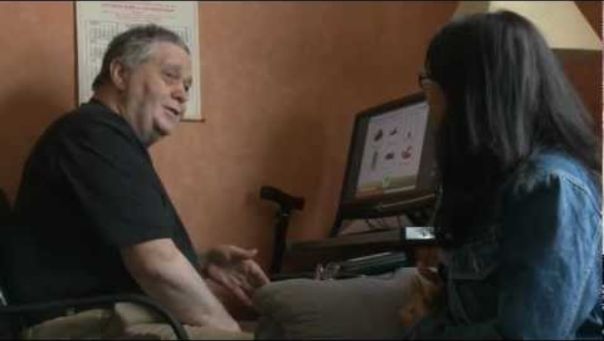
VIDEO: A career in speech and language therapy
Video: A career in speech and language therapy (NHS Health careers, 2012) Click image to access

Slide 19
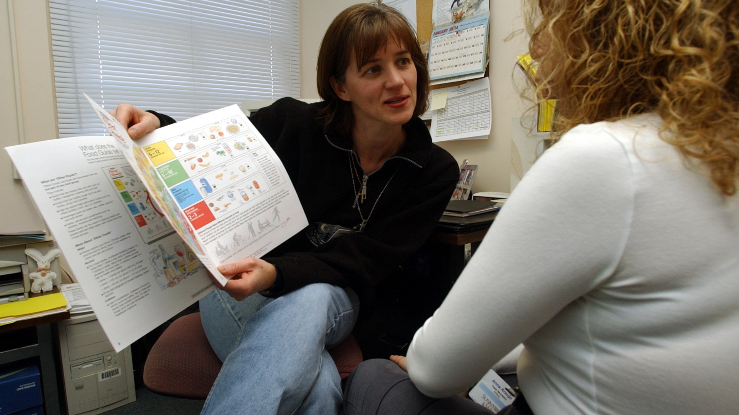

Allied Health Professional Roles
Dietitian - First Contact Practitioner
First Contact Practitioner (FCP) Dietitians working as core members of the Primary Care General Practice team, is an emerging area within the NHS.
FCP Dietitians have a vital role in delivering care and treatment across the life course.
Positioning them in Primary Care, at the start of a patient's journey, allows a focus on prevention and ensures patients are seen by the right healthcare professional in their local community.
This Photo by Unknown Author is licensed under CC BY
The Dietitian will:
Interpret the science of nutrition to improve health and treat diseases/conditions by educating and giving practical, personalised advice to clients, patients, carers and colleagues.
(Association of UK Dietitians, 2023).
For more information about Dietitians in General Practice, please visit BDA and NHSE

Slide 20
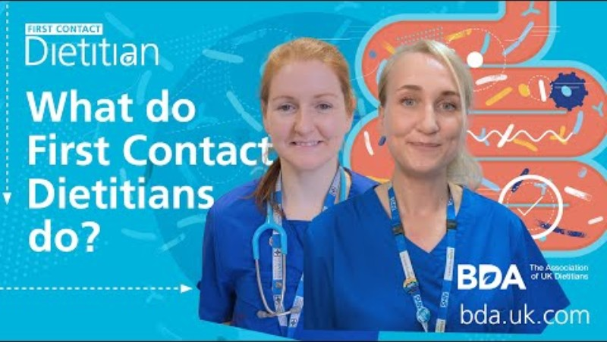
VIDEO: What do First Contact Dietitians do?
Video: What do First Contact Dietitians do? (British Dietetic Association, 2024) Click image to access

Slide 21

Pharmacy Roles
Clinical Pharmacist
Clinical pharmacists are increasingly working as part of general practice teams.
They are highly qualified experts in medicines and can help people in a range of ways.
This includes carrying out structured medication reviews for patients with ongoing health problems and improving patient safety, outcomes and value through a person-centred approach.
Clinical pharmacists work as part of the general practice team to improve value and outcomes from medicines and consult with and treat patients directly.
This includes providing extra help to manage long-term conditions, advice for those on multiple medicines and better access to health checks. The role is pivotal to improving the quality of care and ensuring patient safety.
Having clinical pharmacists in GP practices means that GPs can focus their skills where they are most needed, for example on diagnosing and treating patients with more complex conditions.
This helps GPs to manage the demands on their time
(NHS England, 2023)
For more information about Clinical Pharmacists in General Practice, please visit NHSE and Pharmacy Careers

Slide 22
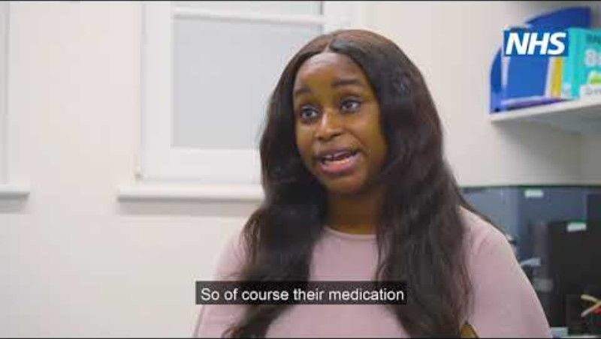
VIDEO: Lara Amusan - Primary Care Network Pharmacist
Video: Lara Amusan - Primary Care Network Pharmacist (NHS Health Careers 2022) Click image to access

Slide 23

Pharmacy Roles
Pharmacy Technician
Pharmacy technicians are responsible for preparing, supplying and administering medicines.
They are key members of the pharmacy and multidisciplinary teams and play a vital role in helping patients get the best outcome from their medicines.
The role involves liaising with patients, other healthcare professionals and customers to ensure the effective and safe use of medicines.
Pharmacy technicians work under the supervision of a pharmacist and are registered healthcare professionals that are responsible and accountable for their own accurate and safe practice
(Careers in Pharmacy, 2023)
For more information about Pharmacy Technicians in General Practice, please visit Pharmacy Careers and NHS Health Careers

Slide 24

VIDEO: Meet our pharmacy technician - working alongside GPs to meet patients' healthcare needs
Video: Meet our pharmacy technician - working alongside GPs to meet patients' healthcare needs (NHSE, 2023) Click image to access

Slide 25
Pharmacy Roles
Pharmacy Assistant/Dispenser
Pharmacy assistants help pharmacists and pharmacy technicians order, prepare and dispense medicines.
Pharmacy Assistants work as part of a wider pharmacy team under the direction of a registered pharmacist.
They work with patients every day and help with their prescriptions.
Pharmacy Assistants will also make sure that the pharmacy has the necessary stock by ordering items as well as receiving, loading and unloading deliveries
(NHS Health Careers, 2023)
For more information about Pharmacy Assistants, please visit Health Careers

Slide 26
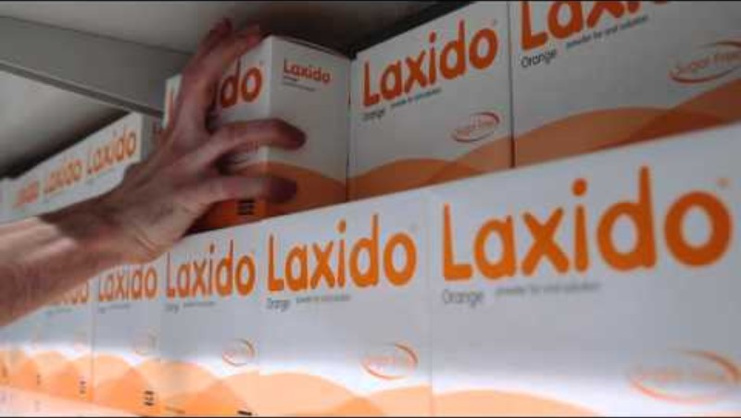
VIDEO: Meet Jacques, a pharmacy assistant
Video: Meet Jacques, a pharmacy assistant NHS Health Careers (2017) Click image to access

Slide 27

Pharmacy Roles
Community Pharmacist
Community pharmacists are well-respected professionals within their local community who use their expert knowledge of medicines to help patients get the best possible care and outcomes from their medicines.
As a community pharmacist, they would be responsible for dispensing prescription and over-the-counter medicines that help people to maintain and improve their lives, in a cost-effective way.
Community Pharmacists will be responsible for constantly monitoring the quality, safety, and use of medicines, which requires a high level of interaction with patients, providing advice and information about the use of medicines and medical appliances.
Community pharmacists work alongside pharmacy technicians and pharmacy support staff, such as pharmacy assistants to deliver the pharmacy service.
Community Pharmacists may work within a high street pharmacy, part of a chain or an independent, or they might work in a GP practice or health centre.
(Careers in Pharmacy, 2023)
For more information about community Pharmacists, please visit Careers in Pharmacy

Slide 28
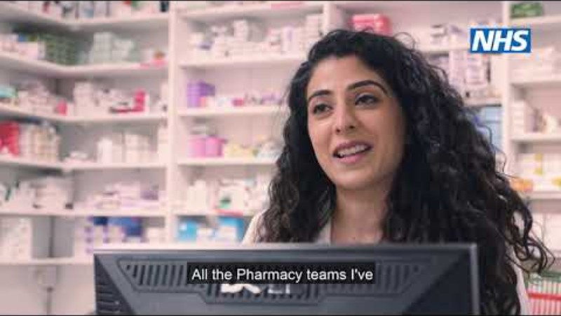
VIDEO: Atika - Community Pharmacist
Video: Atika - Community Pharmacist (NHS Health Careers, 2022) Click image to access

Slide 29

Nursing Roles
General Practice Nurse
General Practice Nurses (GPN) are responsible for the delivery of practice nursing services, working as part of the practice multidisciplinary team, delivering care within their scope of practice to the entitled patient population.
A General Practice Nurse will be responsible for a number of clinical areas such as health promotion, chronic disease management, health prevention, well women and well man clinics, as well as supporting the management team in the reviewing of clinical policy and procedure
(NHS Professionals, 2023)
For more information about General Practice Nurses, please visit NHS Health Careers and NHS Professionals
Enhanced Practice Nurse
Enhanced practice is a level of practice within the healthcare workforce. It covers the graduate professional workforce delivering the majority of clinical activity, those who have moved beyond novice/competent and who are not working at the level of advanced practice (NHSE, 2024).
Enhanced level nursing describes a level that can only be delivered by registered nurses who have gained additional post-registration education and experiential learning in a relevant subject area.
This level can be applied to the full range of registered nurse careers.
The enhanced level is differentiated from other levels by a registered nurse’s expertise in applying specific knowledge and skills to a designated area. For example, this could be a client group, skill set or in an organisational context (RCN, 2024).
For more information about Enhanced Practice Nurses, please visit RCN and NHSE

Slide 30
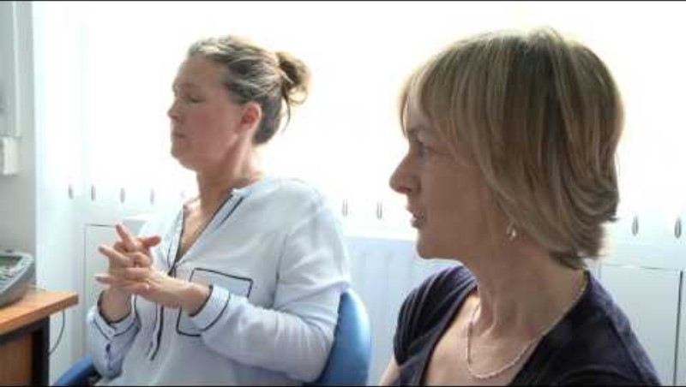
VIDEO: Careers in practice nursing
Video: Careers in practice nursing (NHS Health Careers, 2017) Click image to access

Slide 31

Nursing Roles
Healthcare Assistant/Healthcare Support Worker
Healthcare Assistants (HCA) main role is to support the practice nursing team in the delivery of nursing services, working as part of the practice multidisciplinary team, delivering care within their scope of practice to the entitled patient population.
HCA's deliver and assist clinical staff in the provision of treatment, preventative care, health promotion and patient education
(NHS Professionals, 2023)
HCAs have a duty of care and a legal responsibility to the patients they see.
HCAs are not registered with a professional body.
They are accountable to their employer to follow their contract of employment.
Employers have a responsibility to train, supervise and have oversight of their HCAs. This is until the competence of the HCA can be shown
(CQC, 2022)
For more information about Healthcare Assistants, please visit NHS Professionals and RCN

Slide 32
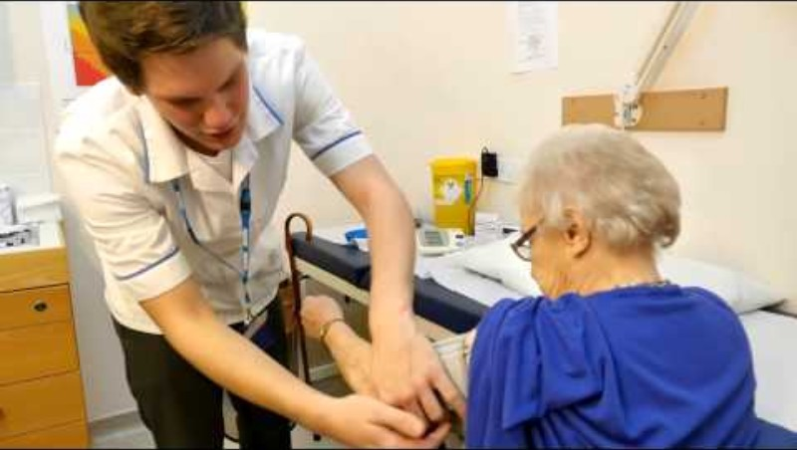
VIDEO: A career in the NHS as a healthcare assistant
Video: A career in the NHS as a healthcare assistant (NHS Health Careers, 2014) Click image to access

Slide 33

Nursing Roles
Nursing associate
A nursing associate is a member of the nursing team in England that helps bridge the gap between health and care assistants and registered nurses.
Nursing associates work with people of all ages, in a variety of settings in health and social care.
The role contributes to the core work of nursing, freeing up registered nurses to focus on more complex clinical care.
It's a stand-alone role that also provides a progression route into graduate level nursing
(Nursing and Midwifery Council, 2023).
For more information about Nursing Associates, please visit NMC

Slide 34
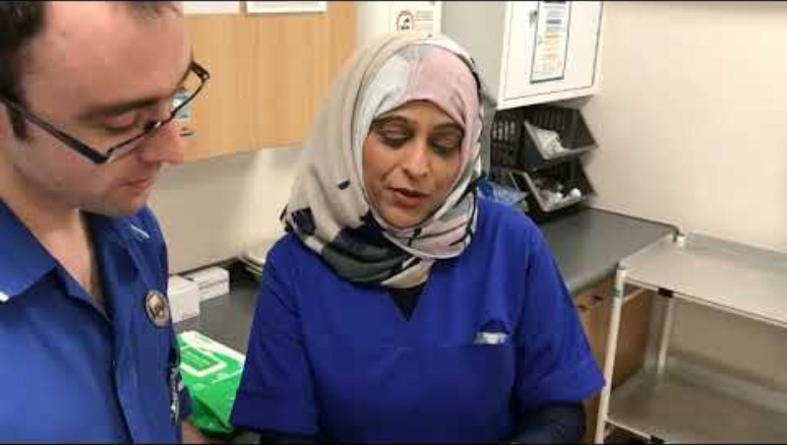
VIDEO: Nursing Associates in General Practice
Video: Nursing Associates in General Practice (NHS England Workforce, Training and Education, 2024) Click image to access

Slide 35

Other Clinical roles
Physician Assistant
Physician Assistants (PAs) are medically trained, generalist healthcare professionals, who work alongside doctors and provide medical care as an integral part of the multidisciplinary team.
Physician Assistants are one of the Medical Associate Professions (MAPs) and can be found working throughout primary and secondary care.
Physician Assistants are overseen by a dedicated medical supervisor, but they can work autonomously with appropriate support (NHSE, 2024)
For more information about Physician Assistants, please visit NHSE and NHS Health Careers

Slide 36
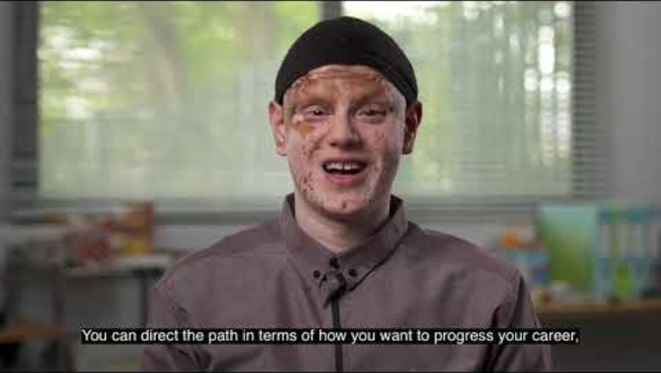
VIDEO: A day in the life of a Physician Assistant in general practice
Video: A day in the life of a Physician Assistant in general practice (NHS England Workforce, Training and Education (2020) Click image to access

Slide 37

Other Clinical roles
Mental Health Practitioner
Mental health practitioners contribute to the NHS Long Term Plan ambition and support adults with severe mental illnesses to live well in their communities.
The Mental Health Practitioner roles were introduced to enable professionals with mental health expertise to be based in GP surgeries or neighbourhood settings, to support people with complex mental health needs and act as a ‘bridge’ between primary care and specialist mental health services.
The role sits alongside NHS Talking Therapies for anxiety and depression, and a range of other roles within primary care that provide mental health support.
Mental health practitioners provide GPs and other primary care staff with timely support and advice, helping to relieve pressure on workloads and build stronger relationships with mental health services
(NHSE, 2023)
A mental health practitioner role can be taken on by a wide range of staff with mental health expertise (ranging from Band 4-8a), including:
peer support workers
community psychiatric nurses
clinical psychologists
mental health social workers
mental health occupational therapists
mental health community connectors
For more information about Mental Health Practitioners, please visit NHSE

Slide 38
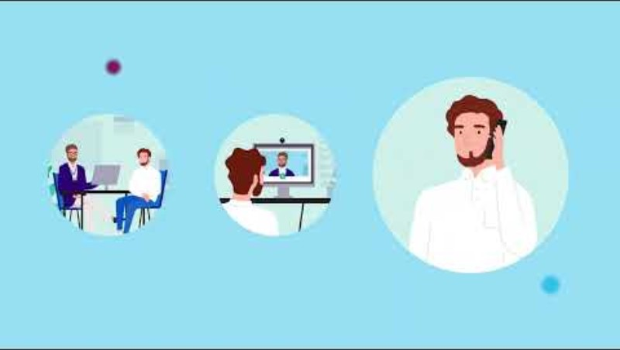
VIDEO: Meet our mental health practitioner - working alongside GPs to meet patients' needs
Video: Meet our mental health practitioner - working alongside GPs to meet patients' needs (NHS England, 2023) Click image to access

Slide 39
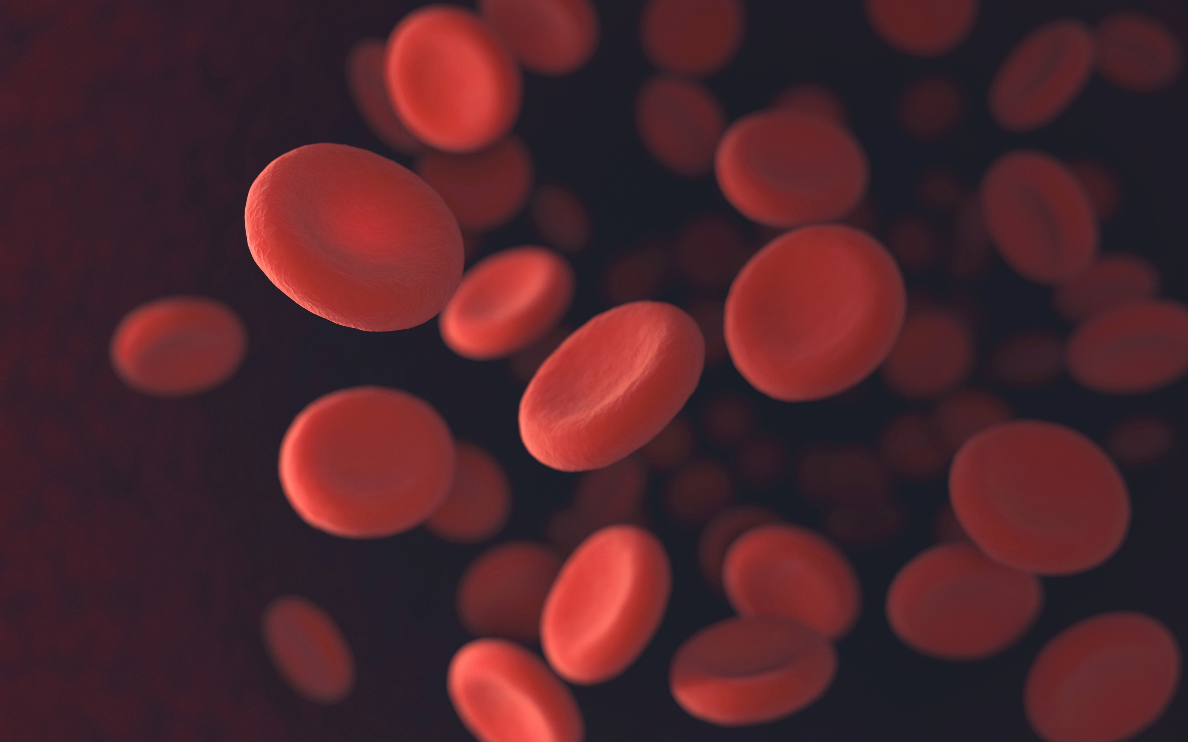

Other Clinical roles
Phlebotomist
A Phlebotomist works with the wider practice multi-disciplinary team. They will ultimately take blood samples from patients which are examined in a laboratory and the results can be used to quickly diagnose diseases and conditions.
(NHS Careers, 2023)
For more information about Phlebotomists, please visit NHS Health Careers
Advanced Practitioner (Multi-professional)
Advanced practitioners (AP) come from a range of professional backgrounds such as nursing, pharmacy, paramedics, Physiotherapy and occupational therapy.
They are healthcare professionals educated to Master’s level and have developed the skills and knowledge to allow them to take on expanded roles and scope of practice caring for patients
(NHSE, 2023)
For more information about Advanced Practitioners, please visit NHSE and NHSE Centre for Advancing Practice

Slide 40
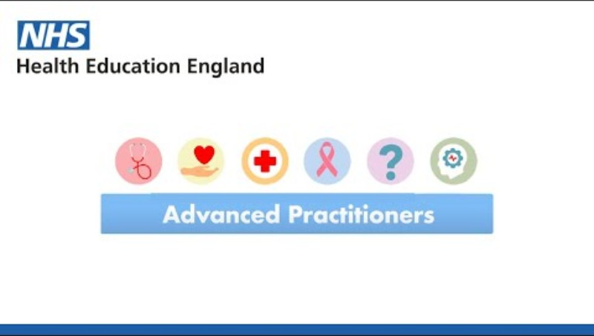
VIDEO: Advanced Practitioners in the workforce
Video: Advanced Practitioners in the workforce (NHS England, 2021) Click image to access

Slide 41
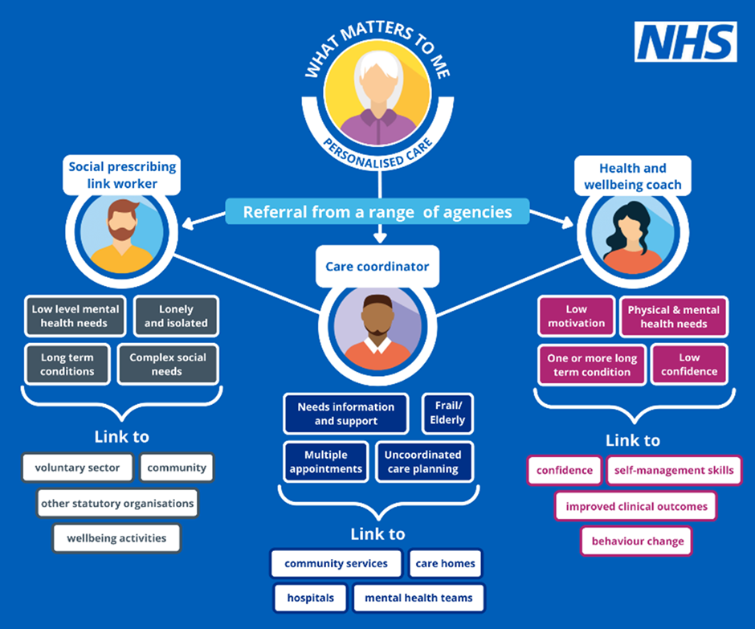
Personalised Care roles
What is Personalised care?
Personalised care represents a major practical change to the NHS and is a key part of the NHS Long Term Plan.
It is a whole system approach that enables a variety of services across the health, social care, public health and community spectrum to be integrated around the individual in order to deliver better outcomes and experiences.
Personalised care simply means that patients have more control and choice when it comes to the way their care is planned and delivered, taking into account individual needs, preferences and circumstances.
Why do we need Personalised Care?
Research has shown that when patients have the opportunity to be involved in decision making around personalised healthcare, there are generally better outcomes and experiences and reduced health inequalities.
For more information about Personalised Care please visit NHS England

Slide 42

Personalised Care roles
Care Co-ordinator
Care co-ordinators help to co-ordinate and navigate care across the health and care system, helping people make the right connections, with the right teams at the right time.
They can support people to become more active in their own health and care and are skilled in assessing people’s changing needs.
Care co-ordinators are effective in bringing together multidisciplinary teams to support people’s complex health and care needs
(Personalised care Institute, 2023).
Video: Meet our care coordinator practitioner - working alongside GPs to meet patients' needs (NHS England, 2023) Click image to access
For more information about Care Co-ordinators, please visit PCI

Slide 43
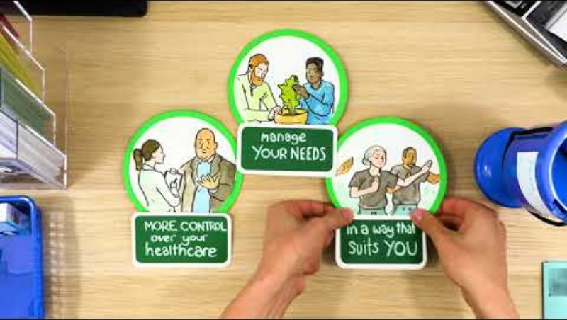
Personalised Care roles
Social Prescribing Link worker
Social prescribing link workers connect people to community-based support, including activities and services that meet practical, social and emotional needs that affect their health and wellbeing.
This includes connecting people to services for example housing, financial and welfare advice.
Social prescribing link workers work collaboratively across the health and care system, targeting populations with greatest need and risk of health inequalities.
They collaborate with partners to identify gaps in provision and support community offers to be accessible and sustainable.
(Personalised care Institute, 2023)
Video: What is social prescribing? (NHS England, 2019) Click image to access
For more information about Social Prescribing link Workers, please visit PCI

Slide 44
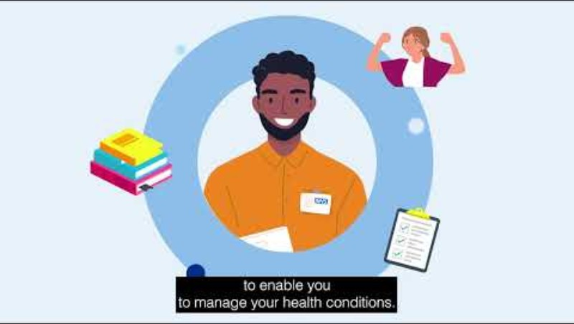
Personalised Care roles
Health and Wellbeing Coach
Health and wellbeing coaches support people to increase their ability to self-manage, motivation levels and commitment to change their lifestyle.
They are experts in behaviour change and focus on improving health related outcomes by working with people to set personalised goals and change their behaviours.
They work with people with physical and/or mental health conditions and those at risk of developing them.
(Personalised care Institute, 2023)
Video: Meet our health and wellbeing coach - working alongside GPs to meet patients' healthcare needs (NHS England, 2023) Click image to access
For more information about Health and Well-being Coaches, please visit PCI

Slide 45
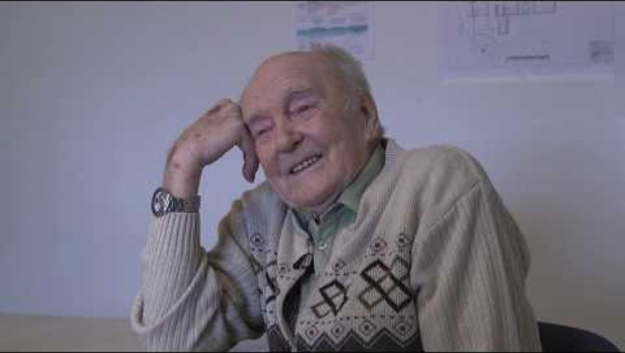
Non-Clinical roles
Care Navigator
Effective navigation is important to providing coordinated person-centred care and support.
Care navigators can occupy many roles and play a crucial part in helping people get the right support, at the right time, to help manage a wide range of needs
Any staff member can be trained to undertake care navigation, irrespective of role.
Many practices will use administrative or reception staff roles to fulfil the care Navigator role, others may have a specific patient liaison or care co-ordinator team.
Clinicians are also able to follow this process.
(NHSE, 2024)
Video: Leading Change, Adding Value - Primary Care Navigators (NHS England, 2018) Click image to access
For more information about Care Navigators, please visit NHSE

Slide 46


Non-Clinical roles
Practice Manager
Practice managers (PM's) are vital to the successful running of GP surgeries. Practice Managers manage the business aspect of the surgery, making sure that patients are at the centre of the surgery's operations.
PM's are integral to the smooth and effective running of a GP practice. Depending on the size of the practice, the manager will be involved with a wide range of activities, such as business planning, finance, recruitment of staff, training and IT.
(Health careers, 2023).
General Practice Assistant
As part of the wider team in general practice, General Practice Assistants (GPA's) provide a support role, carrying out administrative tasks, combined in some areas with basic clinical duties. They can help to free up GPs time and contribute to the smooth running of appointments, improving patients experience in the surgery
(Health Education England, 2023)
For more information about General Practice Assistants, please visit NHSE
For additional learning about the GPA role, please see this e-learning module

Slide 47
Further resources
Centre for Advancing Practice | Royal College of nursing
Nursing and Midwifery Council | General Pharmaceutical Council (GPHC)
The Chartered Society Of Physiotherapy | Royal Pharmaceutical Society of GB
The Personalised Care Institute | British Association of Dieticians
National Association for Primary care | National Association of Phlebotomists
General Medical Council | Royal College of Occupational Therapists
College of Paramedics | Royal College of General Practitioners
Royal college of Podiatry | British Medical Association
Royal College of Speech and Language Therapists (RCSLT) | National Academy for Social Prescribing

Slide 48
Module completed
The NHS and Primary care

