Slide 1


Primary care induction Programme
Introduction to Suffolk and North East Essex primary care

Slide 2

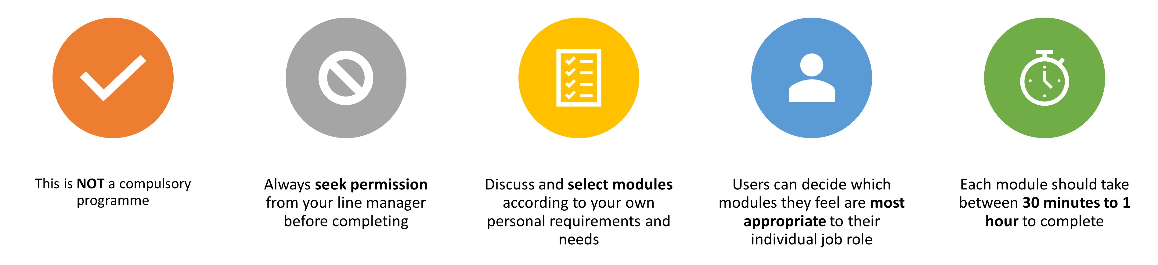
Important Information
Slides are interactive and require the user to click through information using a mouse or space bar.
To view videos in a larger format or full screen, they can be viewed externally at source. Please click the source title e.g. YouTube in bottom left hand corner, and it will take you to a full screen to view.
For Subtitles and closed captions, please click the ‘CC’ logo at the bottom of the video on the left-hand side once launched.
Please note:
The information included in this programme is correct at time of creation. Whilst we have made our best endeavours to make sure the information and materials included in this programme are from reputable sources, if you feel something has been missed or find any errors, please contact us as soon as possible. Thank you.
Suffolk and North east Essex Training Hub
training.hub@snee.nhs.uk

Slide 3

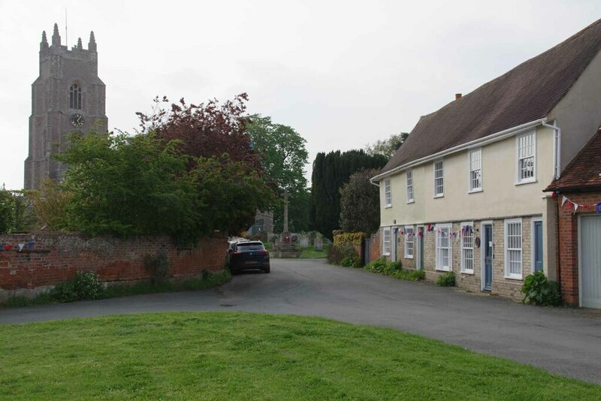
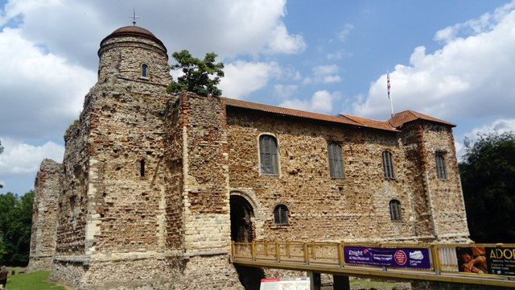
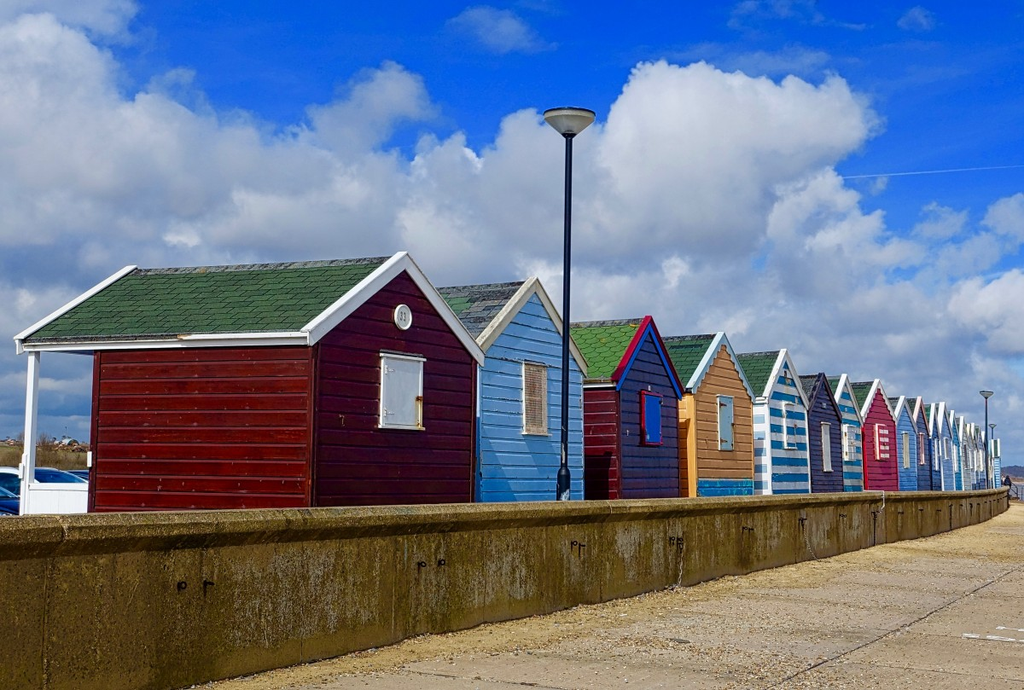
SNEE Primary care
Welcome to Suffolk and North east Essex Primary care
We are part of the wider Integrated Care System.
SNEE primary care is located in the East of England which is currently home to 6.3 million people (Health profile for England, 2021) .
The population of SNEE is currently approximately 1 million.
There are 1,072,747 people registered with GP's across SNEE.
Suffolk and North East Essex primary care services are an innovative, dedicated and evolving sector.
There are new, multi-professional roles being incorporated into teams, and each play a vital role in the collaborative working the region is continually aspiring towards. The health and care experience of the people of SNEE will be improved as a result of this collaborative working.
Patient safety and the quality of health care in SNEE is at the heart of all ambitions (SNEE Training Hub 2024)
These photos by Unknown Author are licensed under CC BY-SA

Slide 4

VIDEO: SNEE Training Hub: Why work in SNEE?
VIDEO: SNEE Training Hub: Why work in SNEE? (SNEE Training Hub, 2022) Click image to access

Slide 5
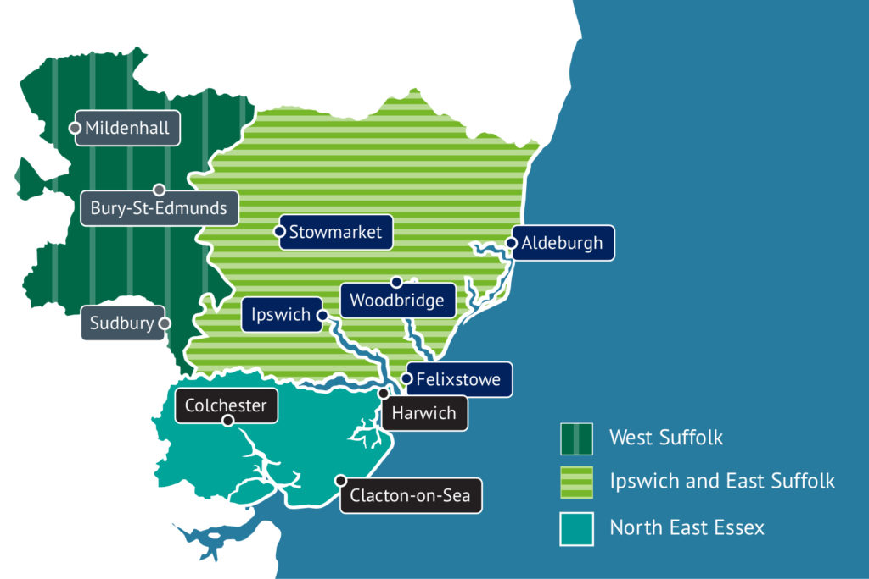
Introduction to our Alliances
In Suffolk and North East Essex there are three health and wellbeing Alliances:
North East Essex Alliance
West Suffolk Alliance
Ipswich and East Suffolk Alliance
Each is defined by the footprint of local health and care partners as well as natural geography, developing differently according to local circumstances.
Each Alliance is responsible for the coordination, planning and delivery of primary medical care, community services, integrated services, and personalised care with the place area.
(SNEE ICS, 2024)
For more information on SNEE Alliances please visit: Working Together in Place Based Alliances - Suffolk & North East Essex Integrated Care System
SNEE ICB Alliance map 2025: accessed here

Slide 6
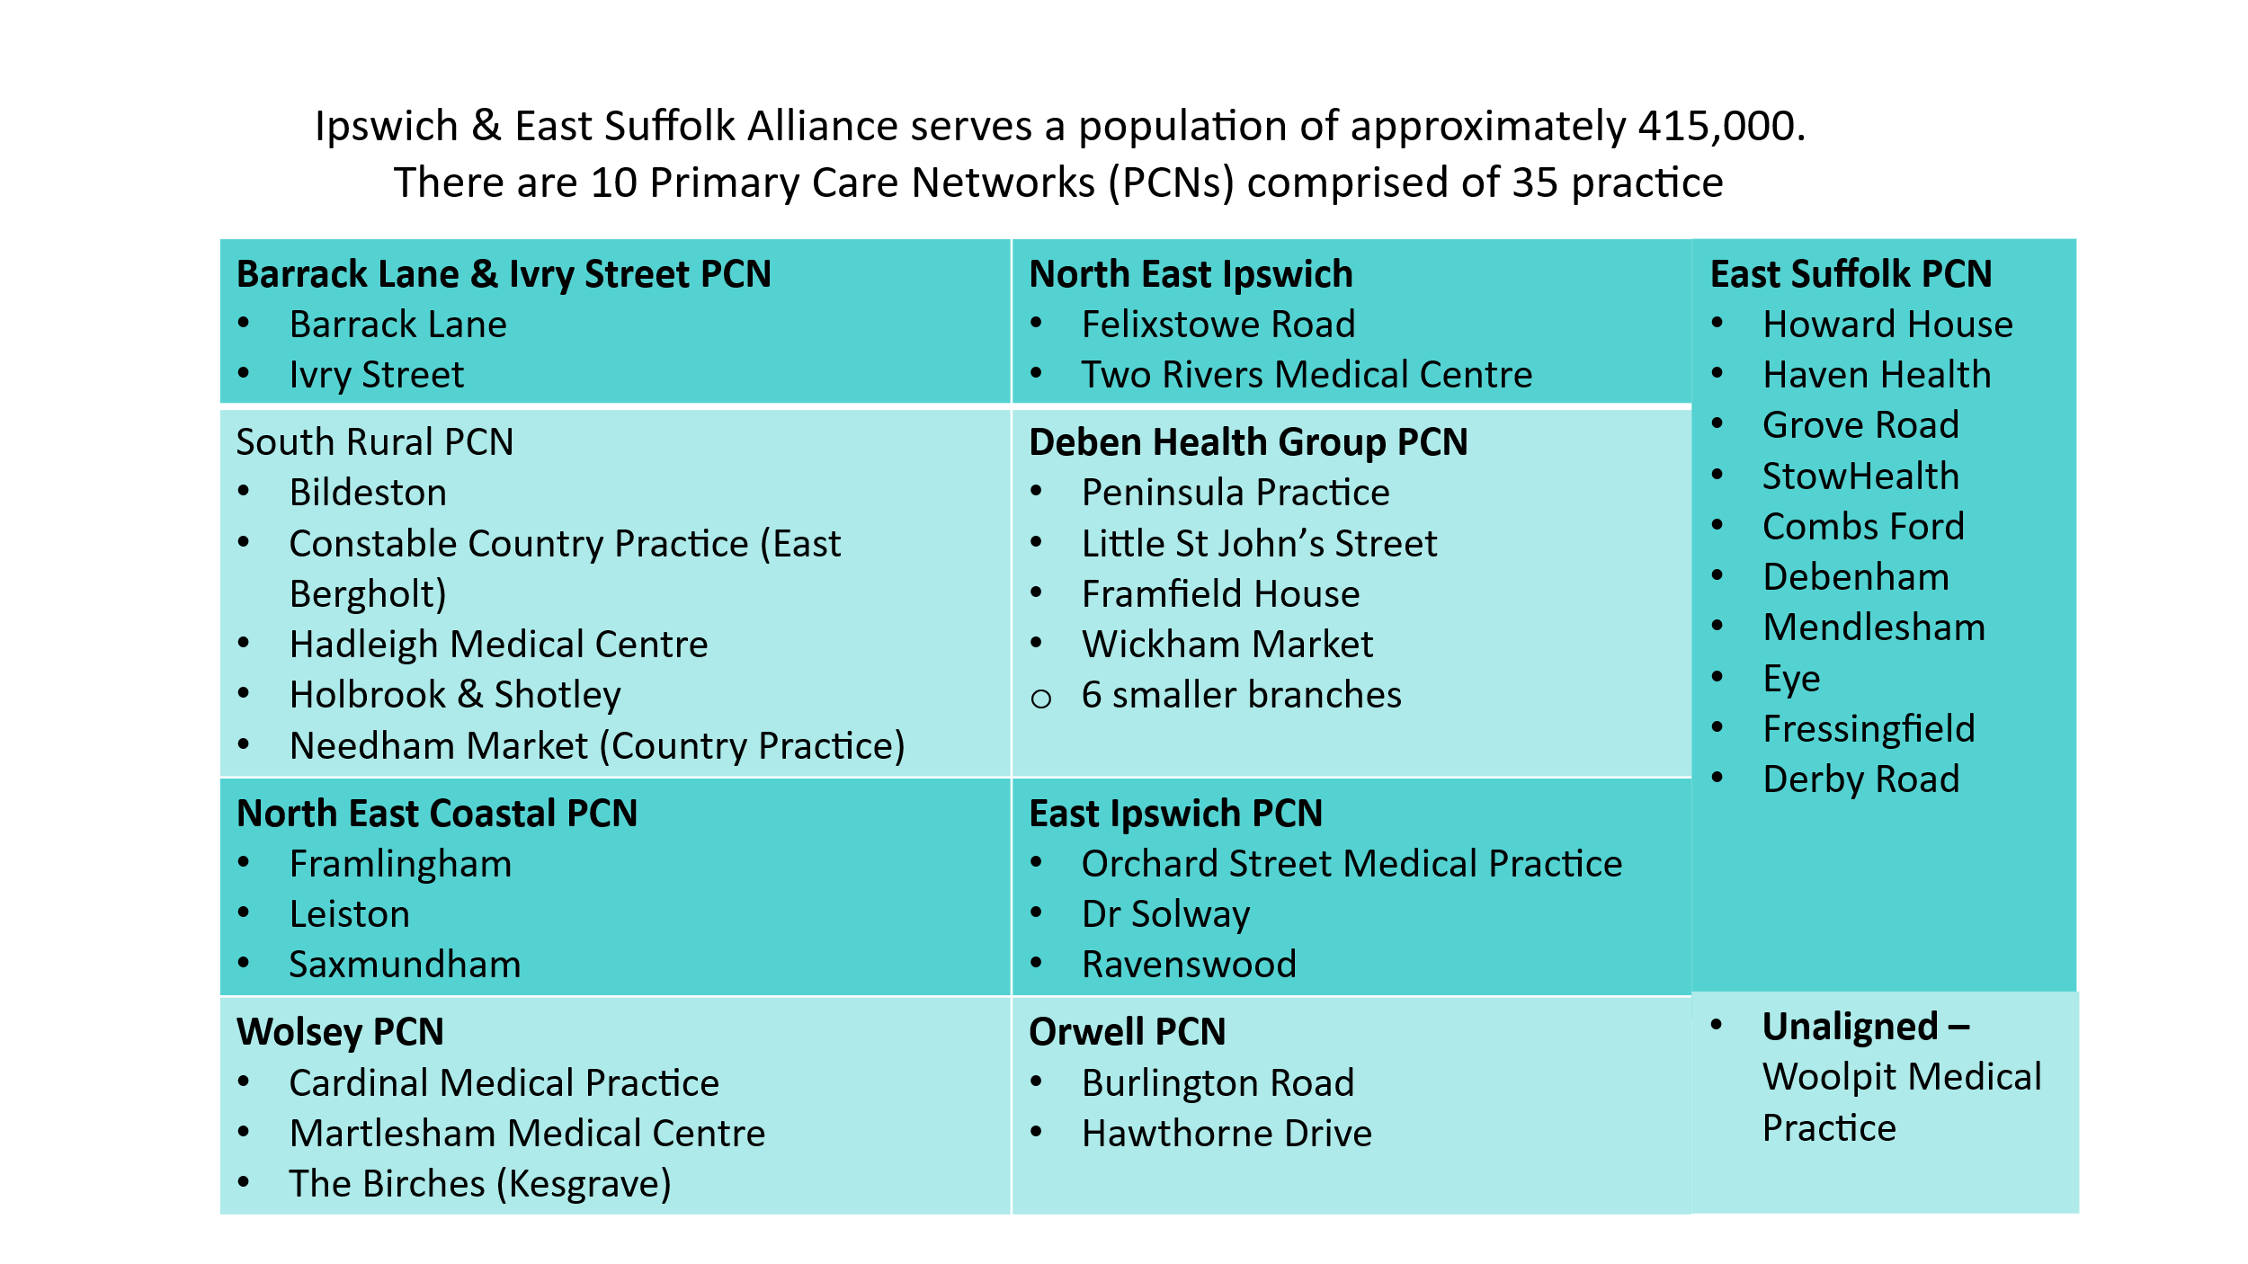
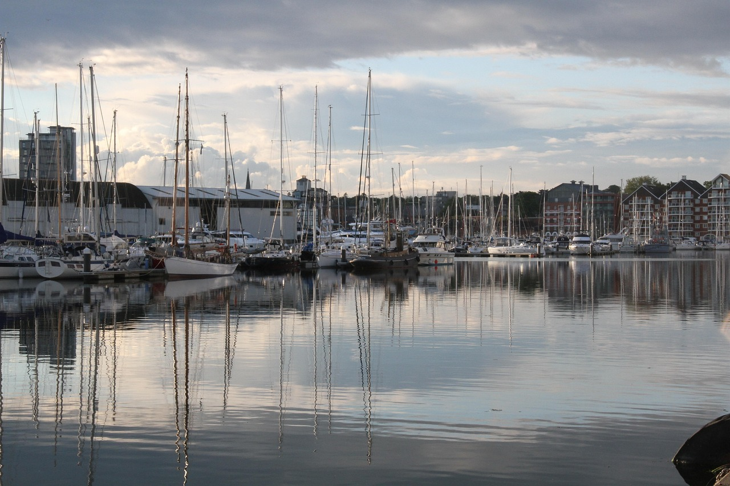
Ipswich and East Alliance
Ipswich Marina image: Photo by Unknown Author, licensed under CC BY-SA
For more information on Ipswich and east Alliance please visit: Ipswich and East Suffolk Alliance - Suffolk & North East Essex Integrated Care System

Slide 7
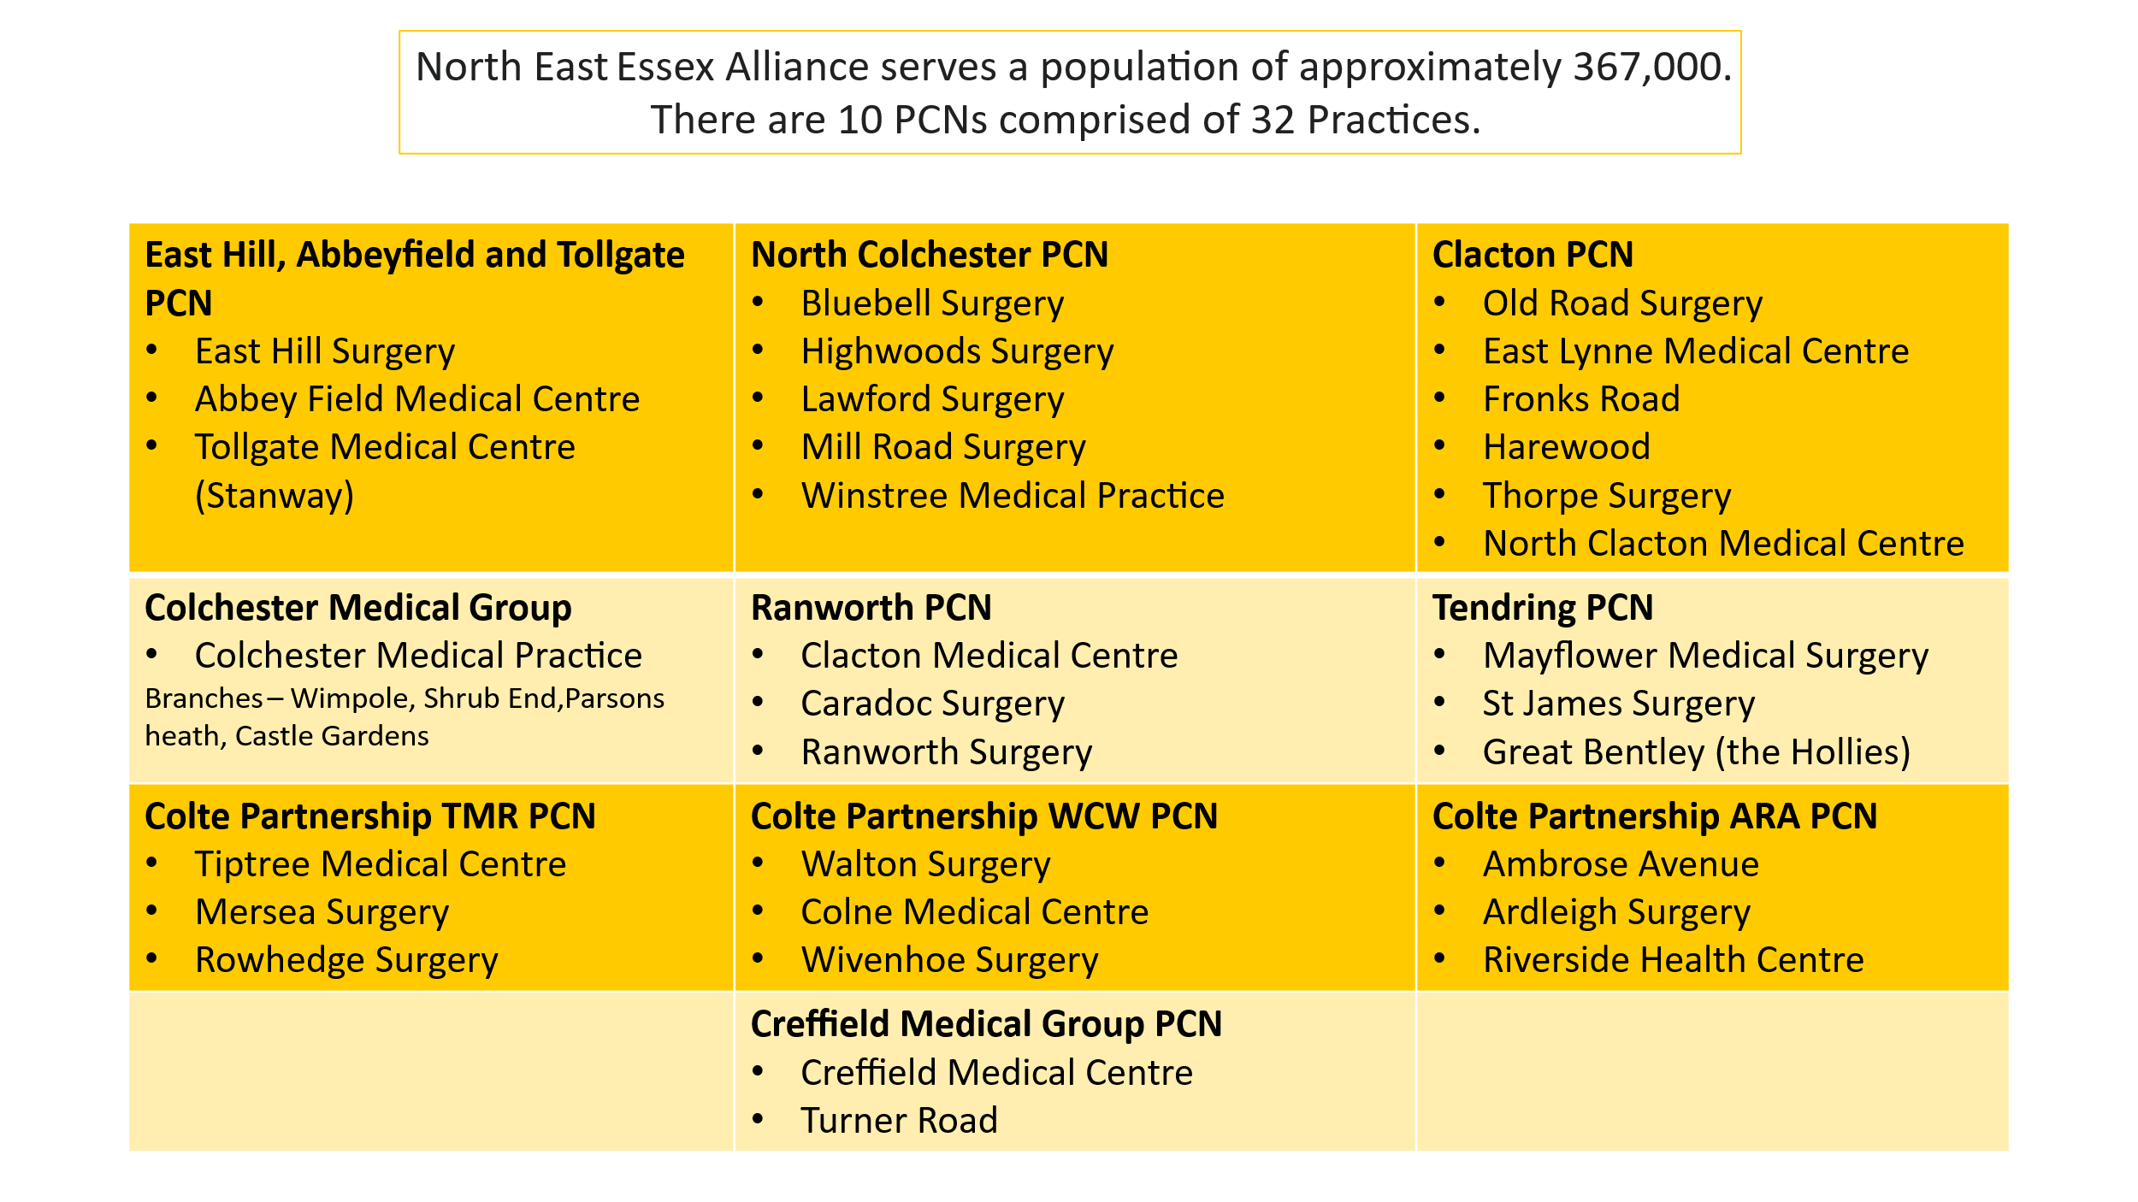
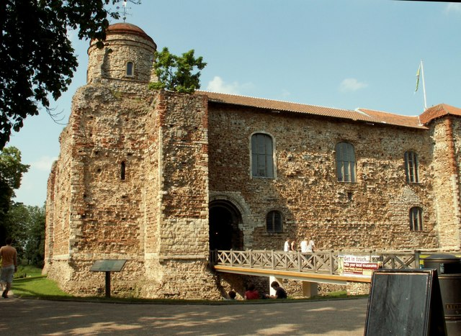
North East Essex Alliance
This Photo by Unknown Author is licensed under CC BY-SA
For more information on the North East Essex Alliance please visit: North East Essex Alliance - Suffolk & North East Essex Integrated Care System

Slide 8
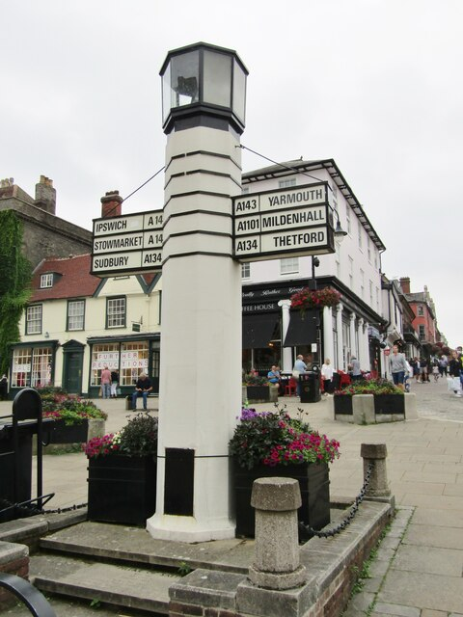
West Suffolk Alliance
West Suffolk serves a population of approximately UPDATE
It has 6 PCNs comprised of 24 Practices.
Blackbourne PCN
–
WGGL PCN
36,289
–
•
Stanton Surgery
•
Clare Guildhall Surgery
•
Botesdale
Health Centre
•
Glemsford
Surgery
•
Woolpit Health Centre
•
Wickhambrook
Surgery
•
The Long Melford Practice
Forest Heath PCN
57,300
–
Bury St Edmunds PCN
–
63,407
•
Brandon Medical Practice
•
Angel Hill Surgery
•
Oakfield Surgery
•
Mount Farm Surgery
•
Orchard House Surgery
•
Swan Surgery
•
Lakenheath Surgery
•
The Guildhall and Barrow Surgery
•
Market Cross Surgery
•
Victoria Surgery
•
Reynard (& Whitehouse) Surgery
•
The Rookery Medical Centre
Sudbury PCN
32,878
21,527
-
Haverhill PCN
-
•
Hardwicke House
•
Unity Health Care
•
Siam Surgery
•
Haverhill Family Practice
This Photo by Unknown Author is licensed under CC BY-SA
For more information on the West Suffolk Alliance please visit: West Suffolk Alliance - Suffolk & North East Essex Integrated Care System

Slide 9

Population Health
What is Population health and why do we need it?
Population health is the study of health outcomes found in a group of individuals.
The study of population health aims to improve physical and mental health outcomes, promote wellbeing and reduce health inequalities across an entire population’
(NHS England, 2022).
For more information on Population Health please visit: A Vision For Population Health | The King's Fund
This Photo by Unknown Author is licensed under CC BY

Slide 10
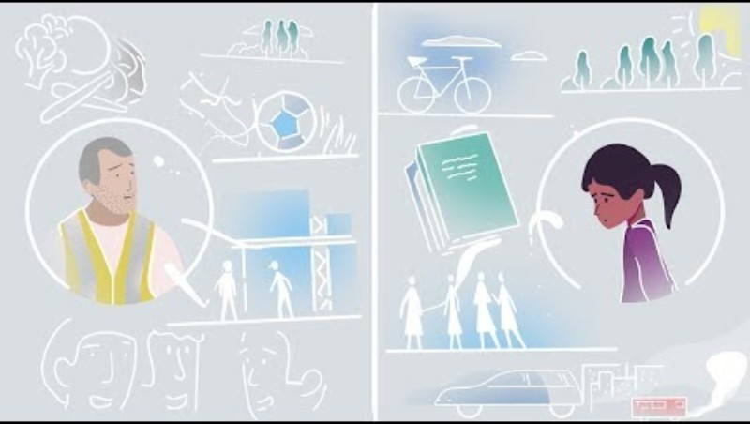
VIDEO: What is population health?
VIDEO: The King’s Fund: What is population Health? (The King’s Fund, 2021) Click image to access

Slide 11
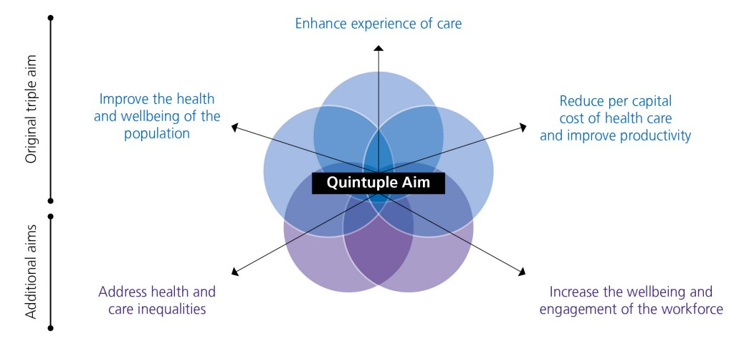
Population Health Management
What is Population Health Management (PHM) and why do we need it?
Population Health Management (PHM) is an approach which supports population health by using linked data to provide new insight, and then taking linked action to improve the social, physical and mental health outcomes and wellbeing of people within and across a defined population, while reducing health inequalities.
(NHS England, 2022)
The population health approach enables care and support to be designed and delivered to meet individuals needs, it means less duplication and reduction in workload. This ensures the right care is given at the right time by the right person
(SNEE ICS, 2023)
SNEE ICB has a dedicated PHM team who help to deliver the SNEE ICB PHM Strategy.
For more information on Population Health Management please visit: Population Health Management - Suffolk & North East Essex Integrated Care System. Please also access ‘Introduction to population health management’ e-lfh module for further learning.

Slide 12
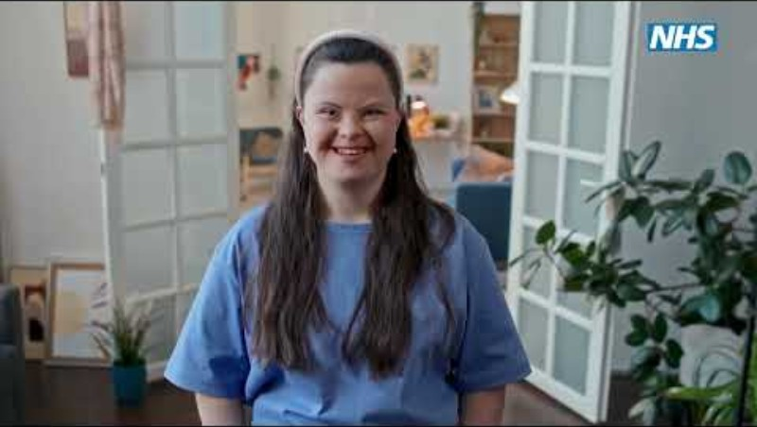
VIDEO: Population health management
VIDEO: Population health management: proactive, targeted healthcare for your community? (NHSE, 2024) Click image to access

Slide 13
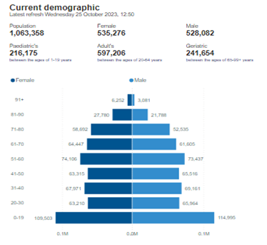
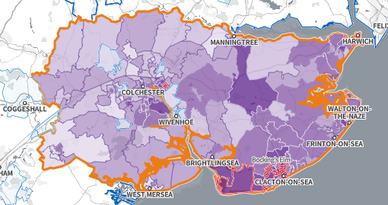
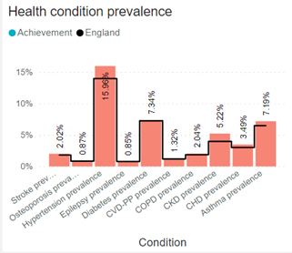
SNEE Population Health Information
The Suffolk and North east Essex overall population is 1,063,358 (October 2023). It is expected to increase to 1,072,532 by 1 July 2024
The population across the ICS is expected to increase by 8% by 2027, and by 14% by 2032. Source: Office for National Statistics
In the Indices of Multiple Deprivation 2019, the Tendring Local Authority area was ranked 32 out of 317 lower tier authorities in England based on the average rank of the LSOAs in this area (where 1= most deprived). This places Tendring in the bottom 10% of most deprived Lower Tier Local Authorities (LTLAs) nationally for the first time.
The county town of Ipswich also has significant pockets of deprived populations, while West Suffolk remains a relatively affluent area.
Population health packs can be provided for an Alliance, PCN, or practice.
For further population health data or for workforce data, please contact the Training Hub training.hub@snee.nhs.uk

Slide 14
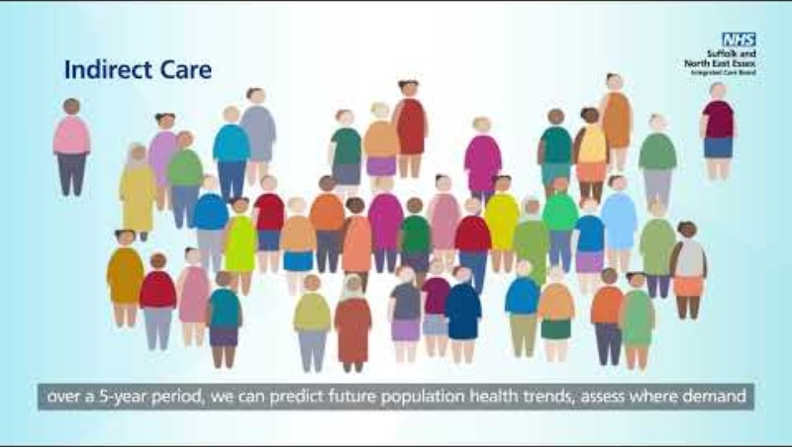
VIDEO: Population Health Management: what does it mean for me?
VIDEO: Population Health Management: what does it mean for me? (NHS Suffolk and North East Essex ICB, 2025) Click image to access

Slide 15
SNEE Integrated Care Board Teams
Medicine Optimisation Teams:
Led by the Suffolk and North east Essex (SNEE) Integrated Care Board (ICB) the teams comprise of Pharmacists, Pharmacy Technicians, Appliance Nurses and Support Officers. There are 3 teams working across our alliances. The medicine optimisation teams are responsible for supporting prescribers and their support of staff across SNEE to ensure prescribing is cost effective, evidence based, safe and sustainable. Further information
ICB Care Homes Team:
The ICB’s Care Homes Team works closely with care homes and providers to help improve the quality of care residents receive. The team help to support care home staff to ensure they are receiving the training they need and complying with CQC guidelines. Further information
Continuing Healthcare Team:
NHS Continuing Healthcare means a package of ongoing care that is arranged and funded solely by the National Health Service (NHS.) It is for a relatively small number of people who have been assessed as having what is called a primary health need. It is the responsibility of the NHS Suffolk and North East Essex Integrated Care Board to decide the appropriate package of support for someone who is eligible for NHS Continuing Healthcare. Further information
Infection Control Team:
The ICB Infection Prevention and Control (ICB IPC) Team aims to ensure that Infection Prevention and Control practice is safe and effective across GP practices in Suffolk and North East Essex. Good infection prevention and control can reduce the risk of healthcare associated infection and demonstrate that services are continually improving (SNEE ICB IPC Strategy, 2023). For further information on the SNEE ICB IPC Team, including how to become an IPC lead or access training opportunities, please visit here
Safeguarding Team:
Every organisation must ensure that they promote the duty of care and protection of vulnerable people and have a clear, well publicised policy of zero tolerance of abuse. To find out more information about SNEE ICB's dedicated safeguarding team, access further training opportunities or obtain support in regard to safeguarding adults and children within your organisation, please visit here

Slide 16
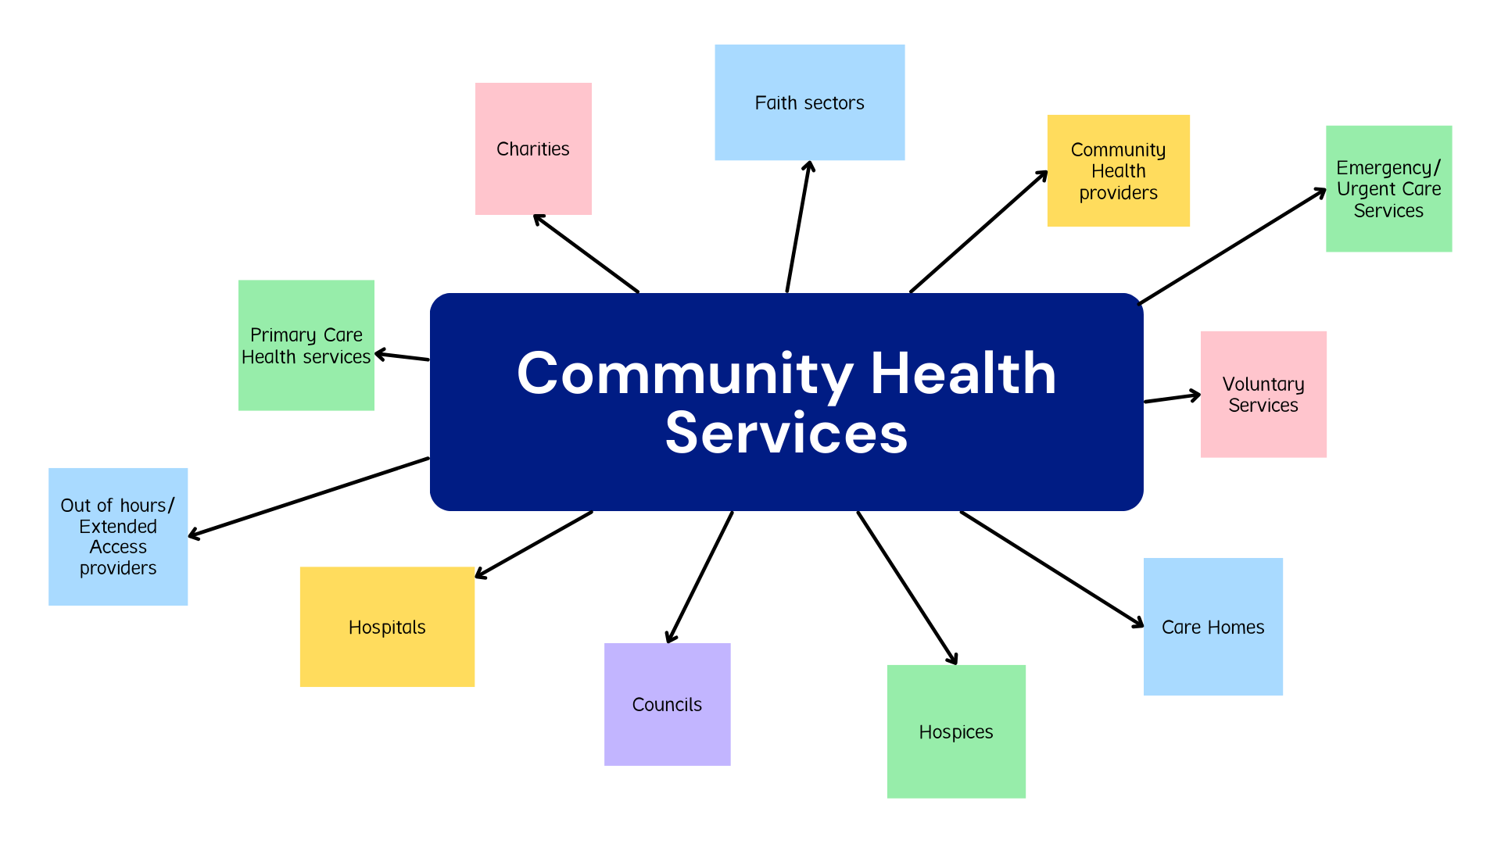
Community Health services
SNEE Community Health Services
The community health services sector covers a wide range of services, from those targeted at people living with complex health and care needs - such as district nursing and palliative care - to health promotion services - such as school nursing and health visiting.
Community services play a key role in keeping people well, treating and managing acute illness and long-term conditions, and supporting people to live independently in their own homes (Kingsfund 2023).
Further information on community services here
For a comprehensive list of SNEE community health providers please click here

Slide 17
Module completed
Introduction to Suffolk and North East Essex primary care

