Slide 1


Primary care induction Programme
The NHS and Primary care

Slide 2

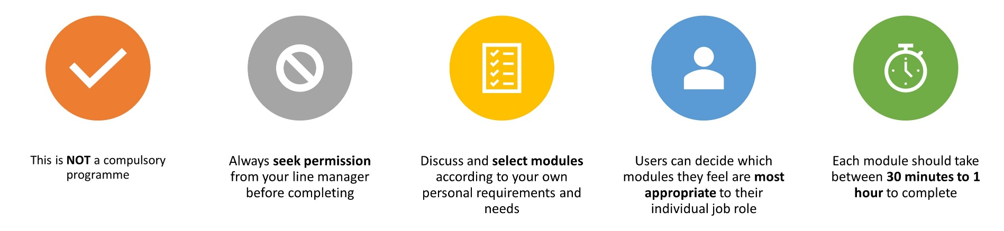
Important Information
Slides are interactive and require the user to click through information using a mouse or space bar.
To view videos in a larger format or full screen, they can be viewed externally at source. Please click the source title e.g. YouTube in bottom left hand corner, and it will take you to a full screen to view.
For Subtitles and closed captions, please click the ‘CC’ logo at the bottom of the video on the left-hand side once launched.
Please note:
The information included in this programme is correct at time of creation. Whilst we have made our best endeavours to make sure the information and materials included in this programme are from reputable sources, if you feel something has been missed or find any errors, please contact us as soon as possible. Thank you.
Suffolk and North east Essex Training Hub
training.hub@snee.nhs.uk

Slide 3
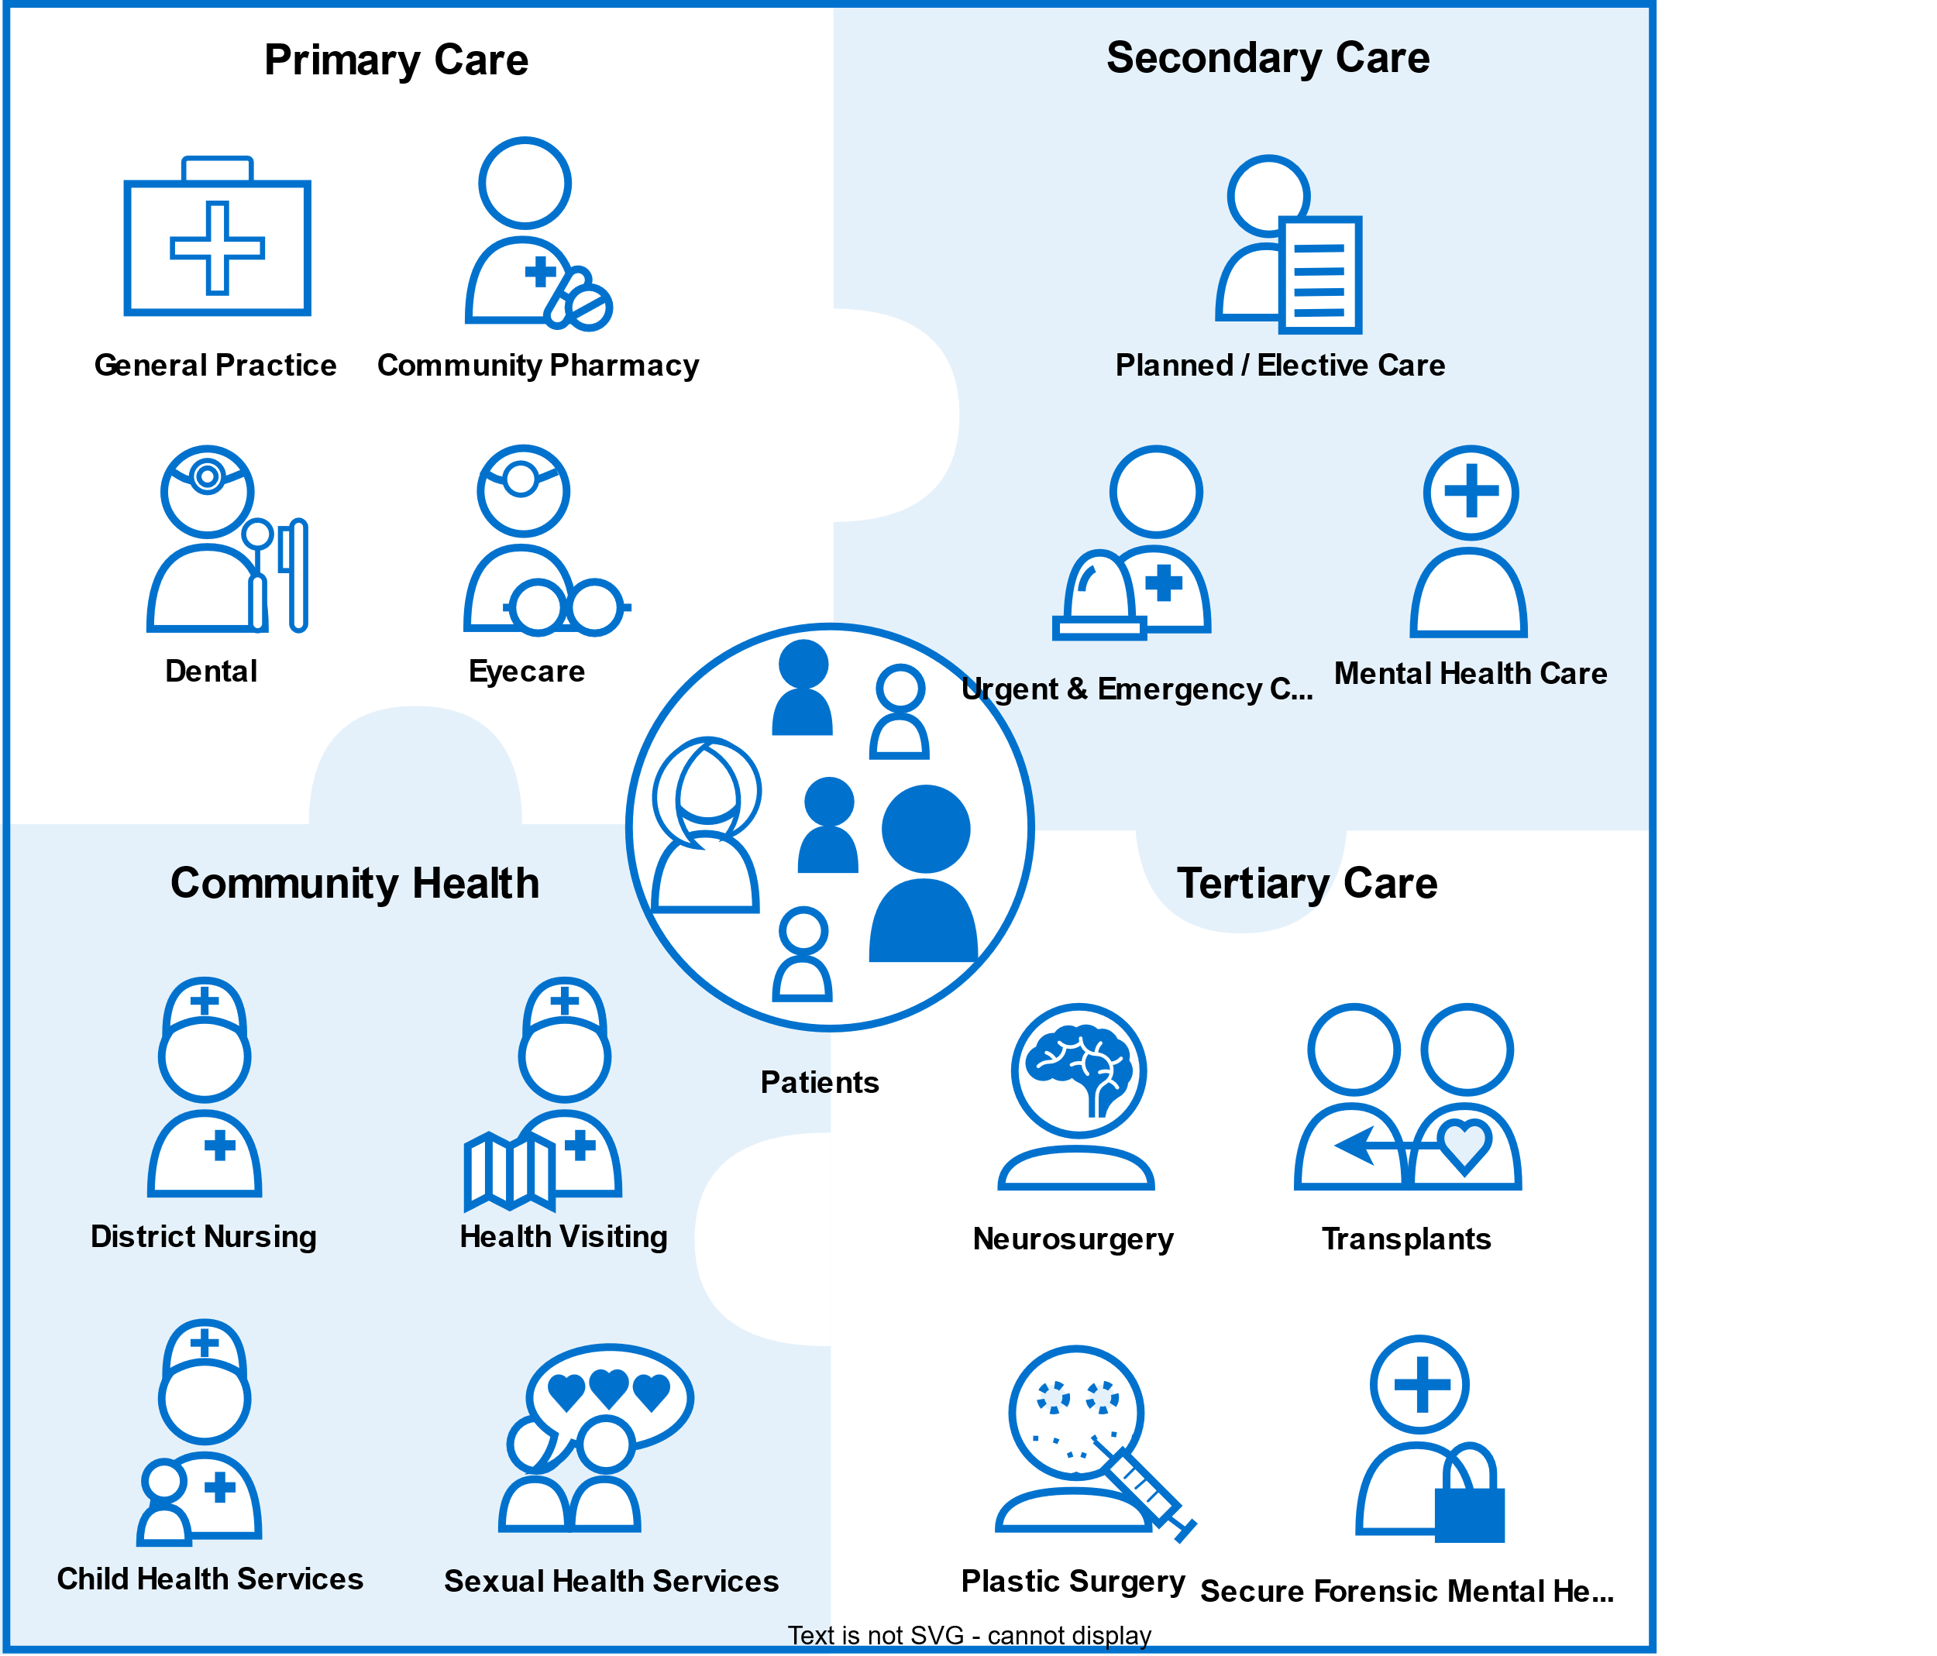
The NHS
The NHS is a complex system, which can sometimes make it difficult to understand – especially working out who is responsible for what. It’s made up of a wide range of different organisations with different roles, responsibilities, and specialities. These organisations provide a variety of services and support to patients and carers.
Primary care is often the first point of contact for people in need of healthcare, provided by professionals such as GPs, dentists, pharmacists and. Primary Care is the ‘front door’ of the NHS.
Secondary care, sometimes referred to as ‘hospital and community care’ can either be planned (elective) care planned (elective) care or urgent and emergency care.
Tertiary care refers to highly specialised treatment such as neurosurgery, transplants, and secure forensic mental health services.
For further explanation of the healthcare ecosystem, please visit here

Slide 4
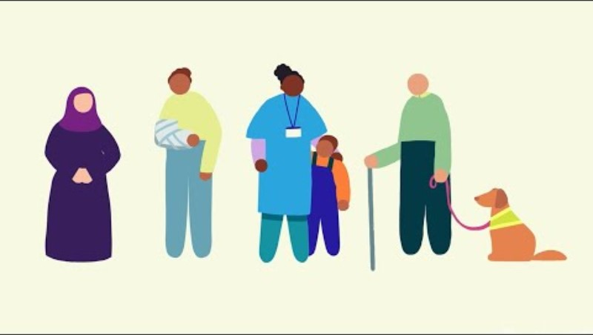
VIDEO: How does the NHS in England work and how is it changing?
VIDEO: How does the NHS in England work and how is it changing (NHSE, 2023) Click image to access

Slide 5
NHS Structure
NHS constitutional values
Working together for patients
Respect and dignity
Commitment to quality of care
Compassion
Improving lives
Everyone counts
Further details of the NHS constitutional values can be found here

Slide 6


What is an ICS?
Introduction to Integrated care Systems
Integrated care systems (ICSs) are partnerships that bring together NHS organisations, local authorities, and others to take collective responsibility for planning services, improving health, and reducing inequalities across geographical areas. ICSs are made up of two key parts:
An integrated care partnership (ICP)
An integrated care board (ICB)
These two parts play different roles when it comes to commissioning and planning.
The ICP is a statutory committee bringing together a broad set of system partners - including local government, the Voluntary, Community and Social Enterprise (VCSE) sector, NHS organisations and others – to develop a health and care strategy for the area. This strategy is a plan to address the wider health care, and public health and social care needs of the local population.
An ICB joins up all parts of the health and care system including GPs, acutes, community care and social care as well as physical and mental health services. People should find it easier to access services, see more joined up care delivery and staff should find it easier to work with colleagues from other organisations. By working collaboratively with a range of organisations, the ICB aims to help people stay healthy, tackling the causes of illness and wider factors that affect health such as education and housing.
For further information on Integrated care systems, please click here

Slide 7
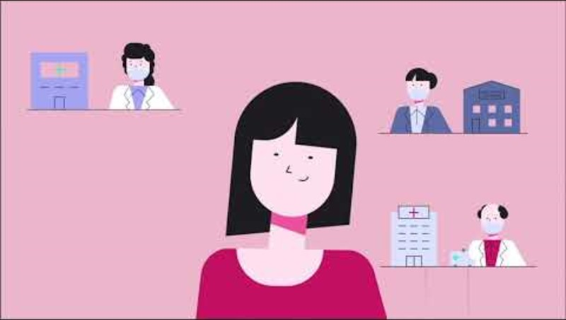
VIDEO: Strong Integrated Systems Everywhere
VIDEO: Strong Integrated Systems Everywhere (NHSE, 2021) Click image to access

Slide 8

Suffolk & North East Essex ICS
In May 2019, Suffolk and North East Essex STP became an Integrated Care System (SNEE ICS). Each organisation keeps their individual responsibility and decision-making powers but recognise the opportunity and benefits of coming together for people who use our health and care services.
The full spectrum of partners engaged in the ICS includes:
NHS Commissioners
NHS Provider Trusts
Local government
NHS regulators
Primary care – GPs, community pharmacists, optometrists and dentists
Independent sector providers
Community and voluntary sectors
Public
Patient and carer groups,
Education and research
Other sectors including industry, police and education.
For further information on SNEE ICS, please view this video
Integrated Care Strategy
SNEE ICS has an Integrated Care Strategy that sets out the ambition of all partners across the region to improve health and care outcomes and experiences for the population of Suffolk and North East Essex. For more information on SNEE ICS, please visit our website: www.sneeICS.org.uk

Slide 9
What is an ICB?
Introduction to Integrated Care Boards
The role of an ICB is to allocate their NHS budget and commission services for the population, taking over the functions previously held by clinical commissioning groups (CCG's) and some of the direct commissioning functions of NHS England.
The majority of NHS England's budget is allocated to ICB's which commission their services for their populations.
The ICB must have regards to its partner ICP's integrated care strategy in carrying out its work.
The ICB is directly accountable to NHS England for NHS spend and performance within the system.
ICB's may choose to exercise their functions through delegating them to place-based communities, but the ICB remains formally accountable.
(Kingsfund, 2022)

Slide 10
Suffolk & North East Essex ICB
The SNEE ICB plans and buys healthcare services for the one million people who live locally. This function is commonly referred to as commissioning. The ICB, together with the ICS, local authorities and other local partners collectively plan health and care services to meet the needs of the population. SNEE ICB works withing a budget which is set by NHS England and works closely with local government and the NHS providers in the SNEE area.
The main aims of the ICB are to:
Keep people as independent as possible for as long as possible
Support residents in self-care and prevention
Reduce the number of unnecessary hospital referrals, avoidable admissions and A&E attendances
Provide care close to home (within the community) as appropriate
Address wider determinants of health such as employment, housing and education to improve outcomes
Make the workforce fit for the future through joint workforce strategies
Improve the health and wellbeing of local people
Improve the quality of local health and care services
Deliver financial stability and efficiencies throughout the local health care system
You can read more about the Suffolk & North East Essex Integrated Care Board here

Slide 11




Introduction to Primary care
Primary Care services provide the first point of contact in the healthcare system, acting as the ‘front door’ of the NHS. Primary Care includes General Practice, Community Pharmacy, Dental, and Optometry Services (NHS England).
For further information about primary care, please click here

Slide 12

What are Primary Care Networks?
Primary care networks (PCN's) form a key building block of the NHS Long-term plan.
Since the NHS was created in 1948, the population has grown, and people are living longer. Many people are living with long term conditions and may need to access their local health services more often.
To meet these needs, GP practices are working together with community, mental health, social care, pharmacy, hospital and voluntary services in their local areas in groups of practices known as primary care networks (PCN's).
PCN's build on existing services and enable greater provision of proactive, personalised, coordinated and more integrated health and social care for people close to home.
(Kingsfund, 2020)

Slide 13
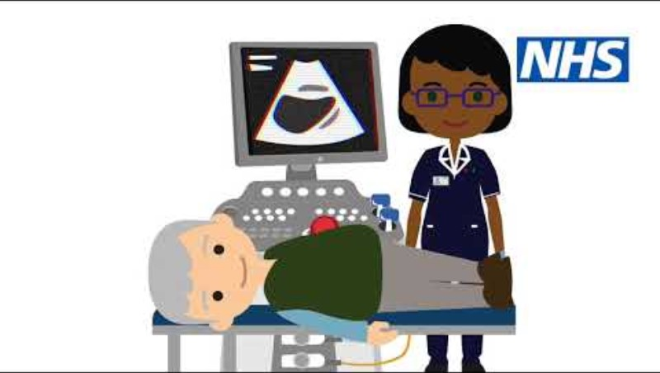
VIDEO: Primary care Networks Animation
VIDEO: Primary care Networks Animation (NHSE, 2019) Click image to access

Slide 14
Integrated Neighbourhood Teams (INTs)
Introduction to Integrated Neighbourhood Teams
Integrated neighbourhood teams (INTs) play a part in bringing statutory services together to work more effectively with voluntary and community organisation and citizens, but this is only one part of a bigger model for neighbourhood health (NHS Confederation, 2024)
Each of SNEE’s place-based alliances is developing multi-professional, and increasingly multi-agency, integrated neighbourhood teams who will deliver the shared ICS ambitions of true integrated care to local communities of typically around 50,000.
There are 8 INTs in Ipswich and east Suffolk alliance and 6 each in north-east Essex and west Suffolk, a total of 20 across the system.
The INTs are all at different levels of maturity and they are not as yet all geographically aligned with the evolving Primary Care Networks. However, the common trend is for them to incorporate local representation from all the ICS partner agencies, with the core being community services, social care and community mental health and to each have a leadership structure
For further information on SNEE Integrated Neighbourhood Teams, please click here

Slide 15

What are GP Federations?
GP federations are groups of primary care providers, which form a single organisational entity and work together as economies of scale to deliver services for their combined patient communities (NHS Confederation, 2021).
There are around 200 GP federations in England (NHSE, 2021).
For more information on GP Federations, please see here

Slide 16
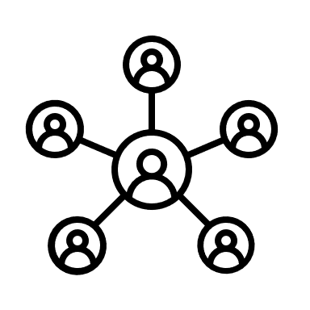

Suffolk GP Federation
GP Suffolk Federation is a not-for-profit organisation owned by 57 GP practices.
Their aim is to:
‘find innovative solutions to the challenges currently faced by the NHS, while at the same time protecting the interests of general practice and ensuring that patients continue to receive the very best care.’
For further information please visit their website: https://suffolkfed.org.uk/.
Additional information here

Slide 17

GP Primary Choice (North East Essex GP Federation)
GP Primary Choice is a primary care provider company based in North East Essex owned by 32 GP Practices in the locality.
Values:
  Locally run to meet local needs;
  Securing quality for our patients;
  Trusted and based on patient preference;
  Sustainable and viable
Aims:
  Supporting Primary Care to be sustainable
  To reduce Health Inequalities
  To improve access to services within the local communities
For further information please visit: https://www.gpprimarychoice.co.uk/

Slide 18
Module 1 - completed
The NHS and Primary Care
Please complete this feedback form when you have completed your module(s). This helps us to monitor the program to ensure it is as efficient and accurate as possible.

